Slide 2
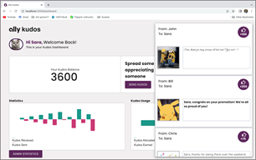
team-ally-artwork-1.png

Slide 3
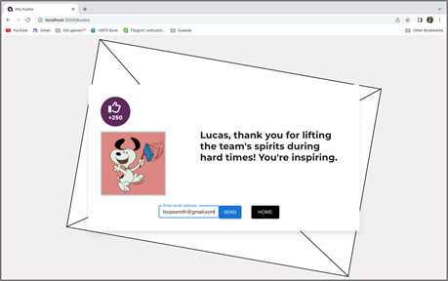
team-ally-artwork-2.png

Slide 4
team-ally-artwork-3.png

Slide 5
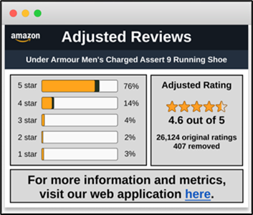
team-amazon-artwork-1.png

Slide 6
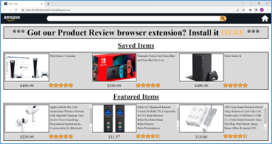
team-amazon-artwork-2.png

Slide 7
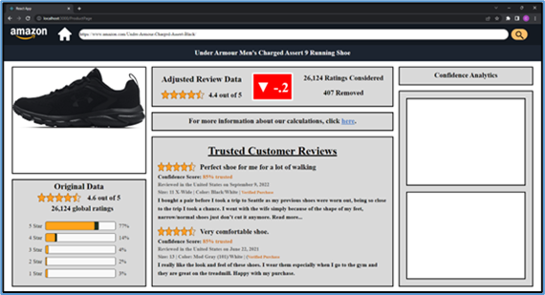
team-amazon-artwork-3.png

Slide 8
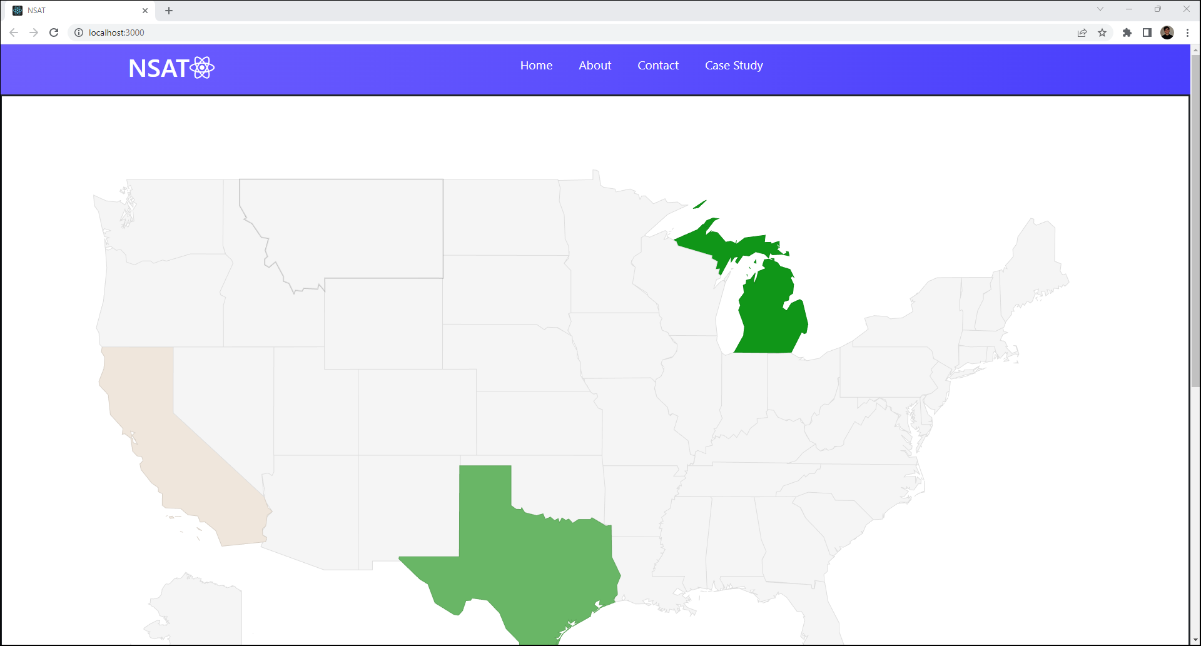
team-anthropocene-institute-artwork-1.png

Slide 9
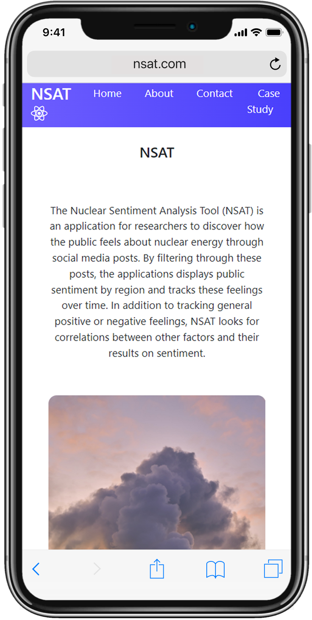
team-anthropocene-institute-artwork-2.png

Slide 10
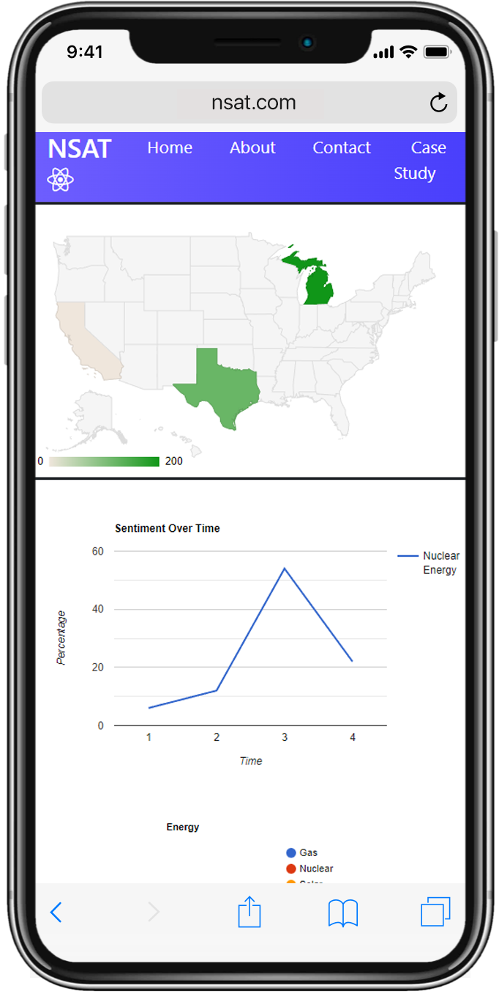
team-anthropocene-institute-artwork-3.png

Slide 11
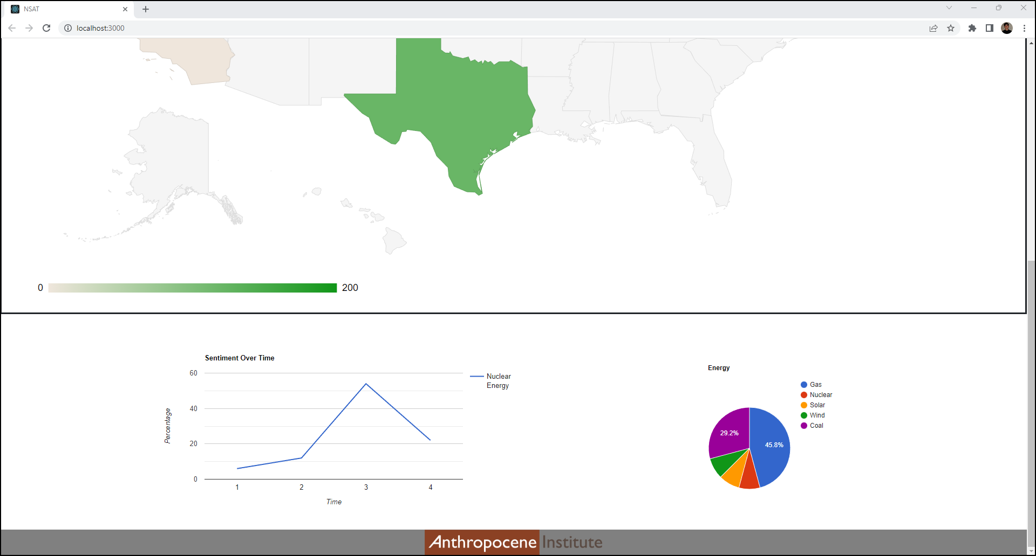
team-anthropocene-institute-artwork-4.png

Slide 12
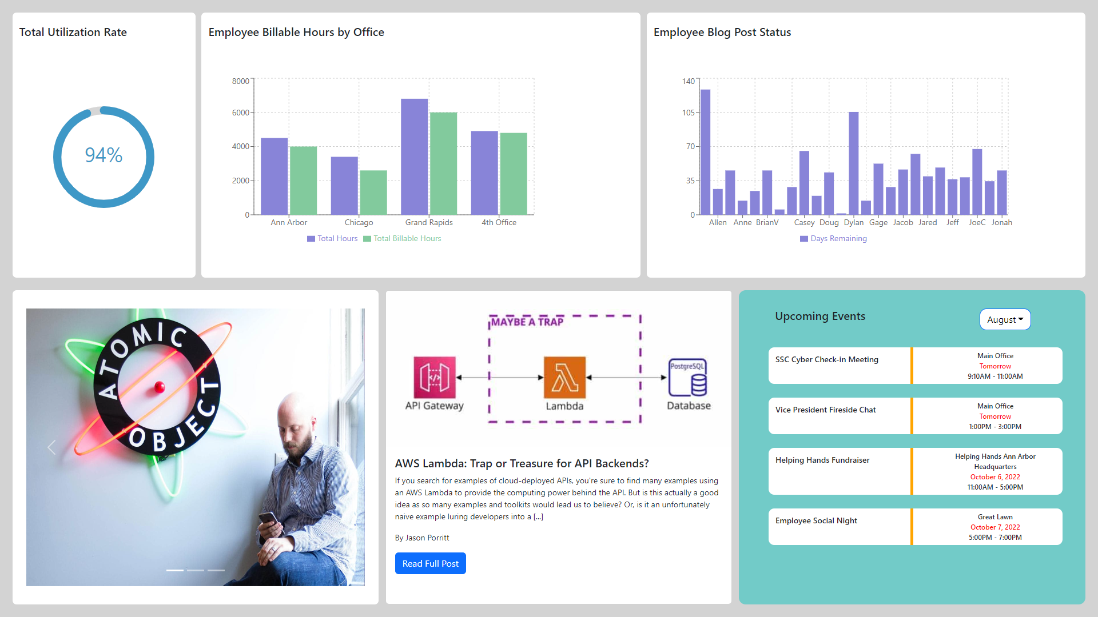
team-atomic-object-artwork-1.png

Slide 13
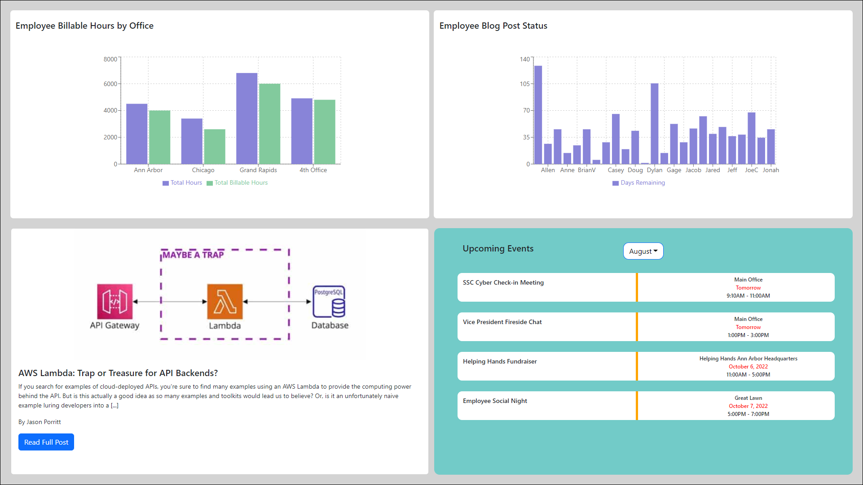
team-atomic-object-artwork-2.png

Slide 14
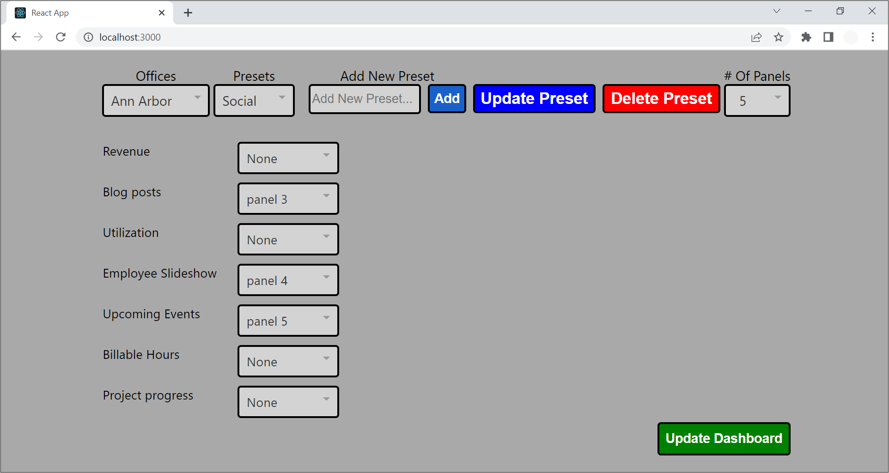
team-atomic-object-artwork-3.png

Slide 15
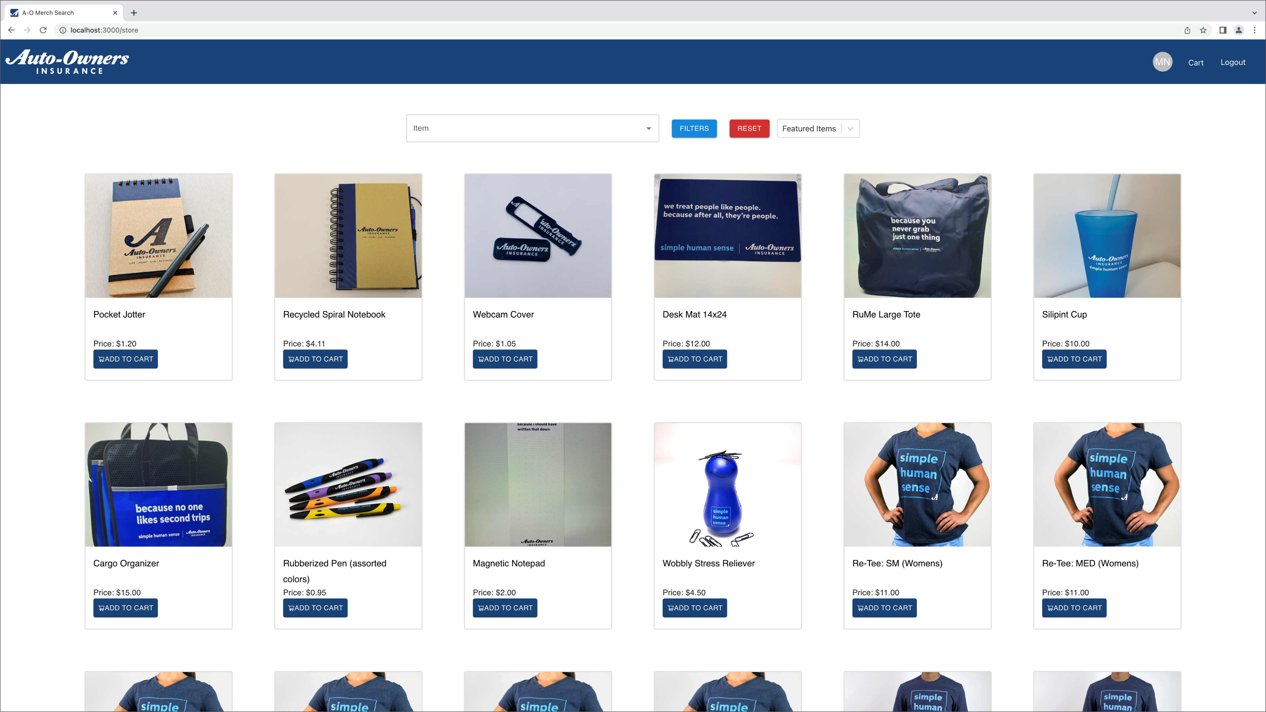
team-auto-owners-artwork-1.png

Slide 16
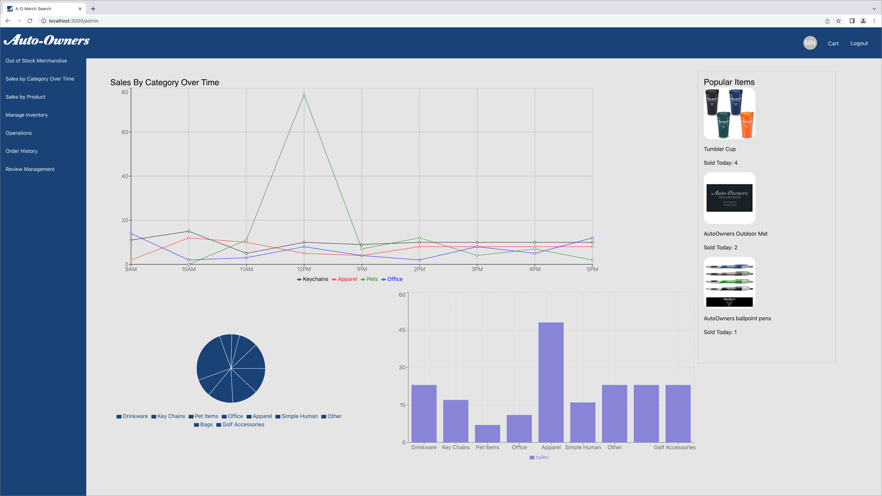
team-auto-owners-artwork-2.png

Slide 17
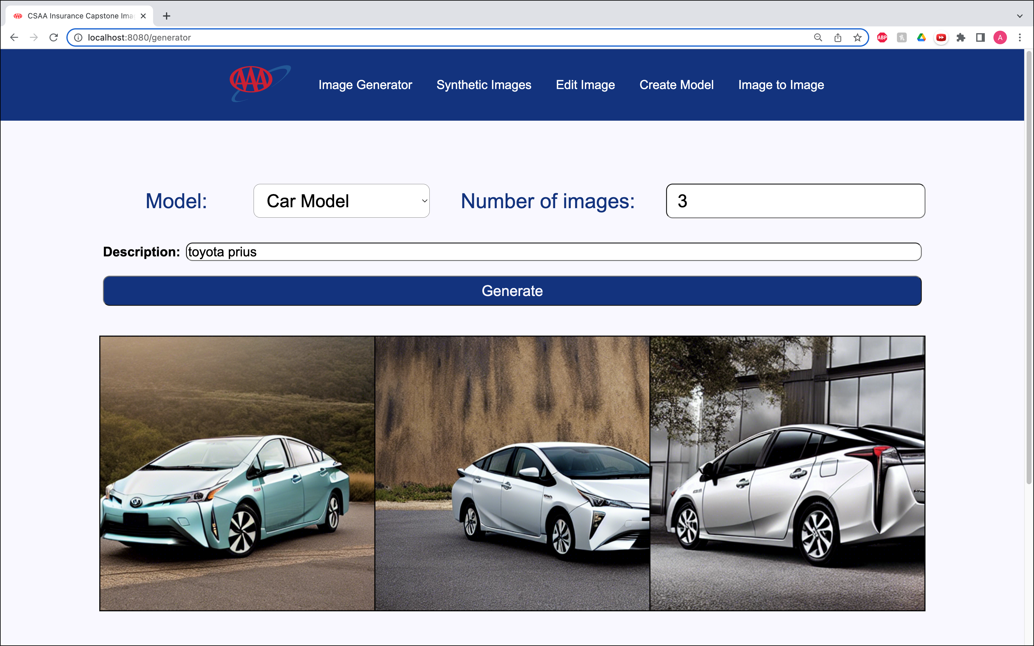
team-csaa-insurance-artwork-1.png

Slide 18
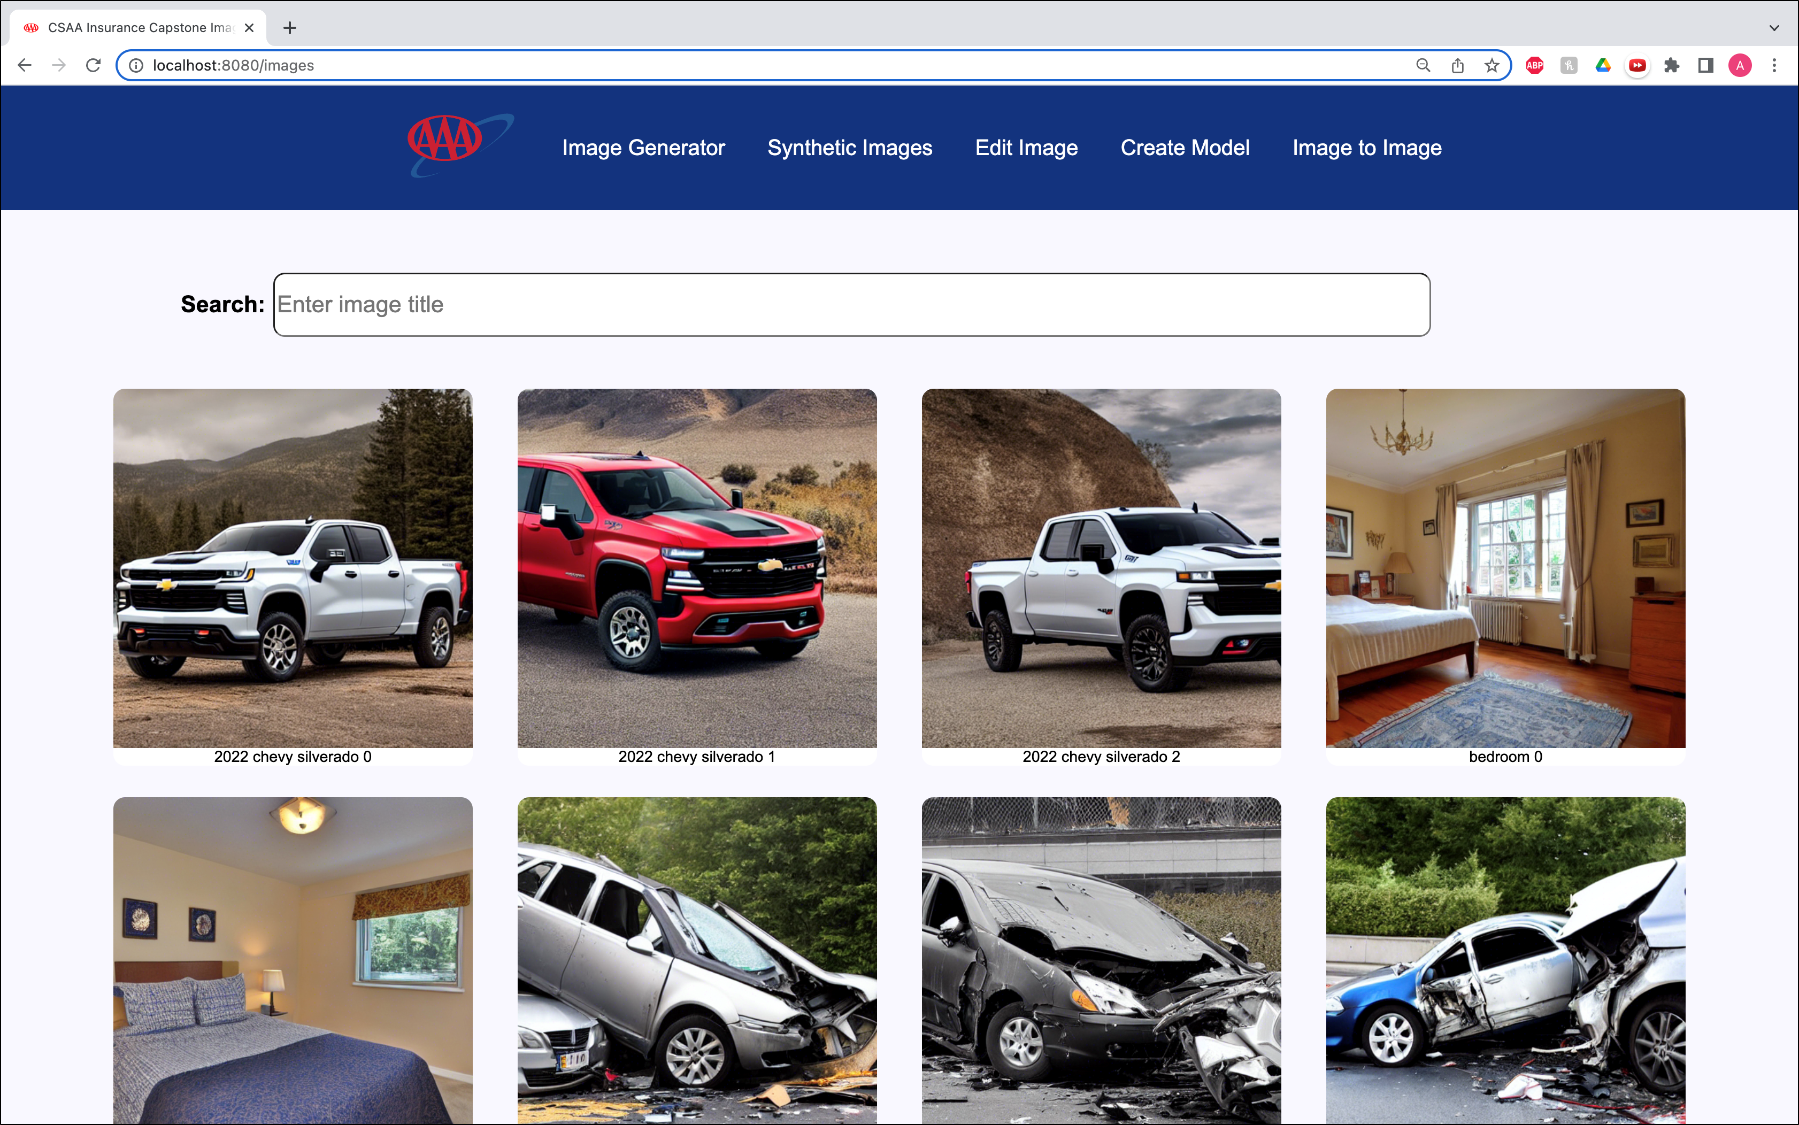
team-csaa-insurance-artwork-2.png

Slide 19
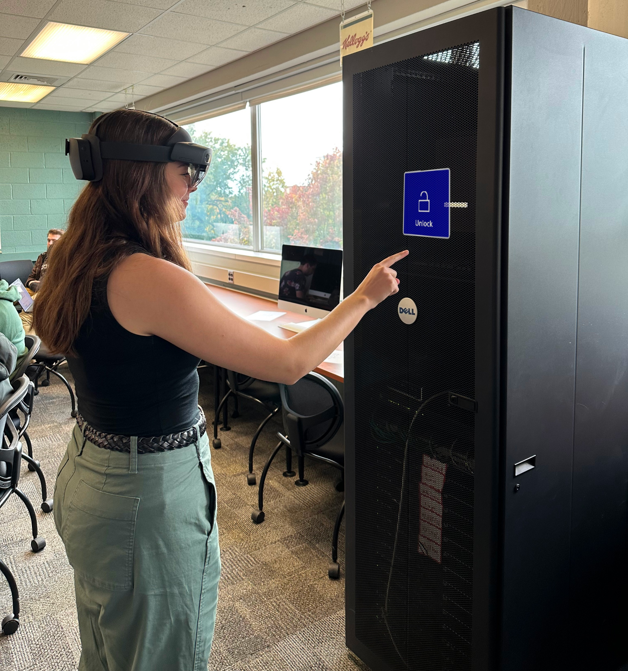
team-gm-artwork-1.png

Slide 20
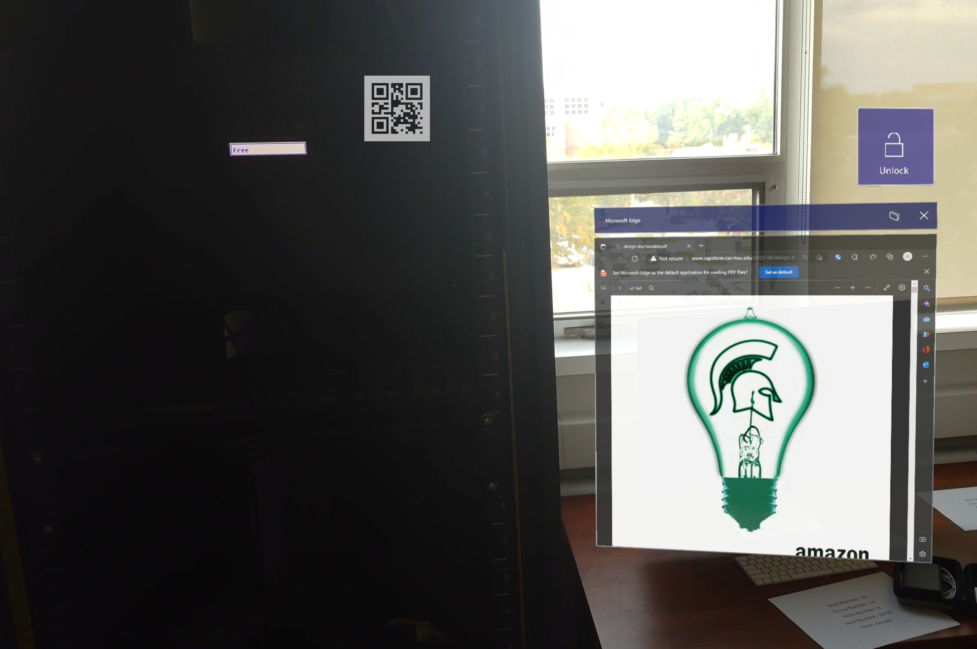
team-gm-artwork-2.png

Slide 21
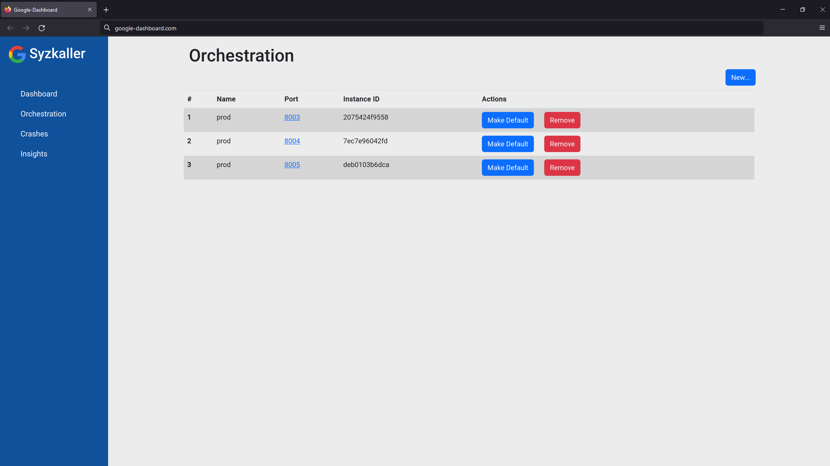
team-google-artwork-1.png

Slide 22
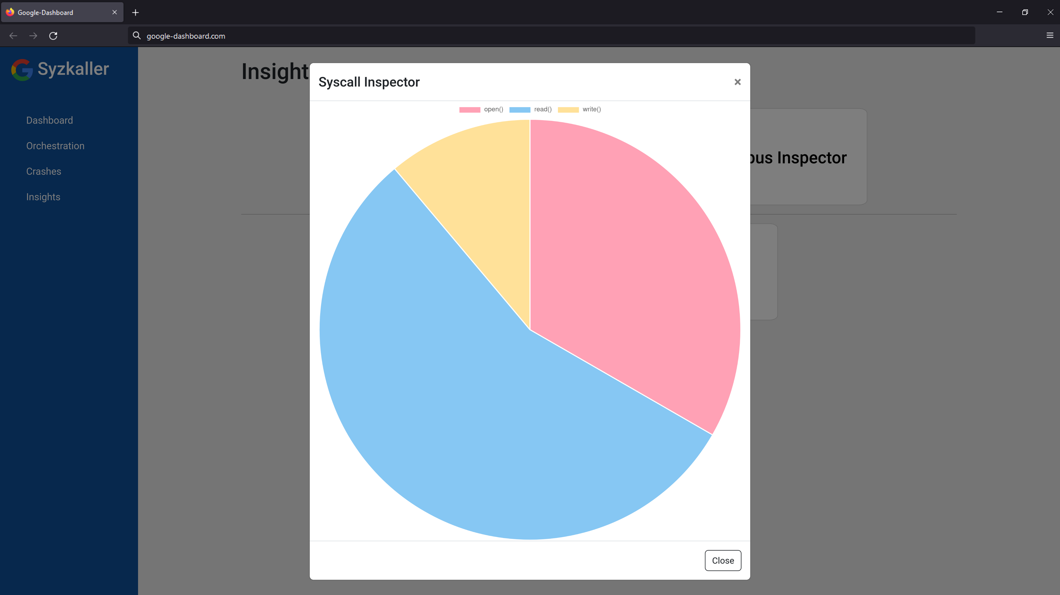
team-google-artwork-2.png

Slide 23
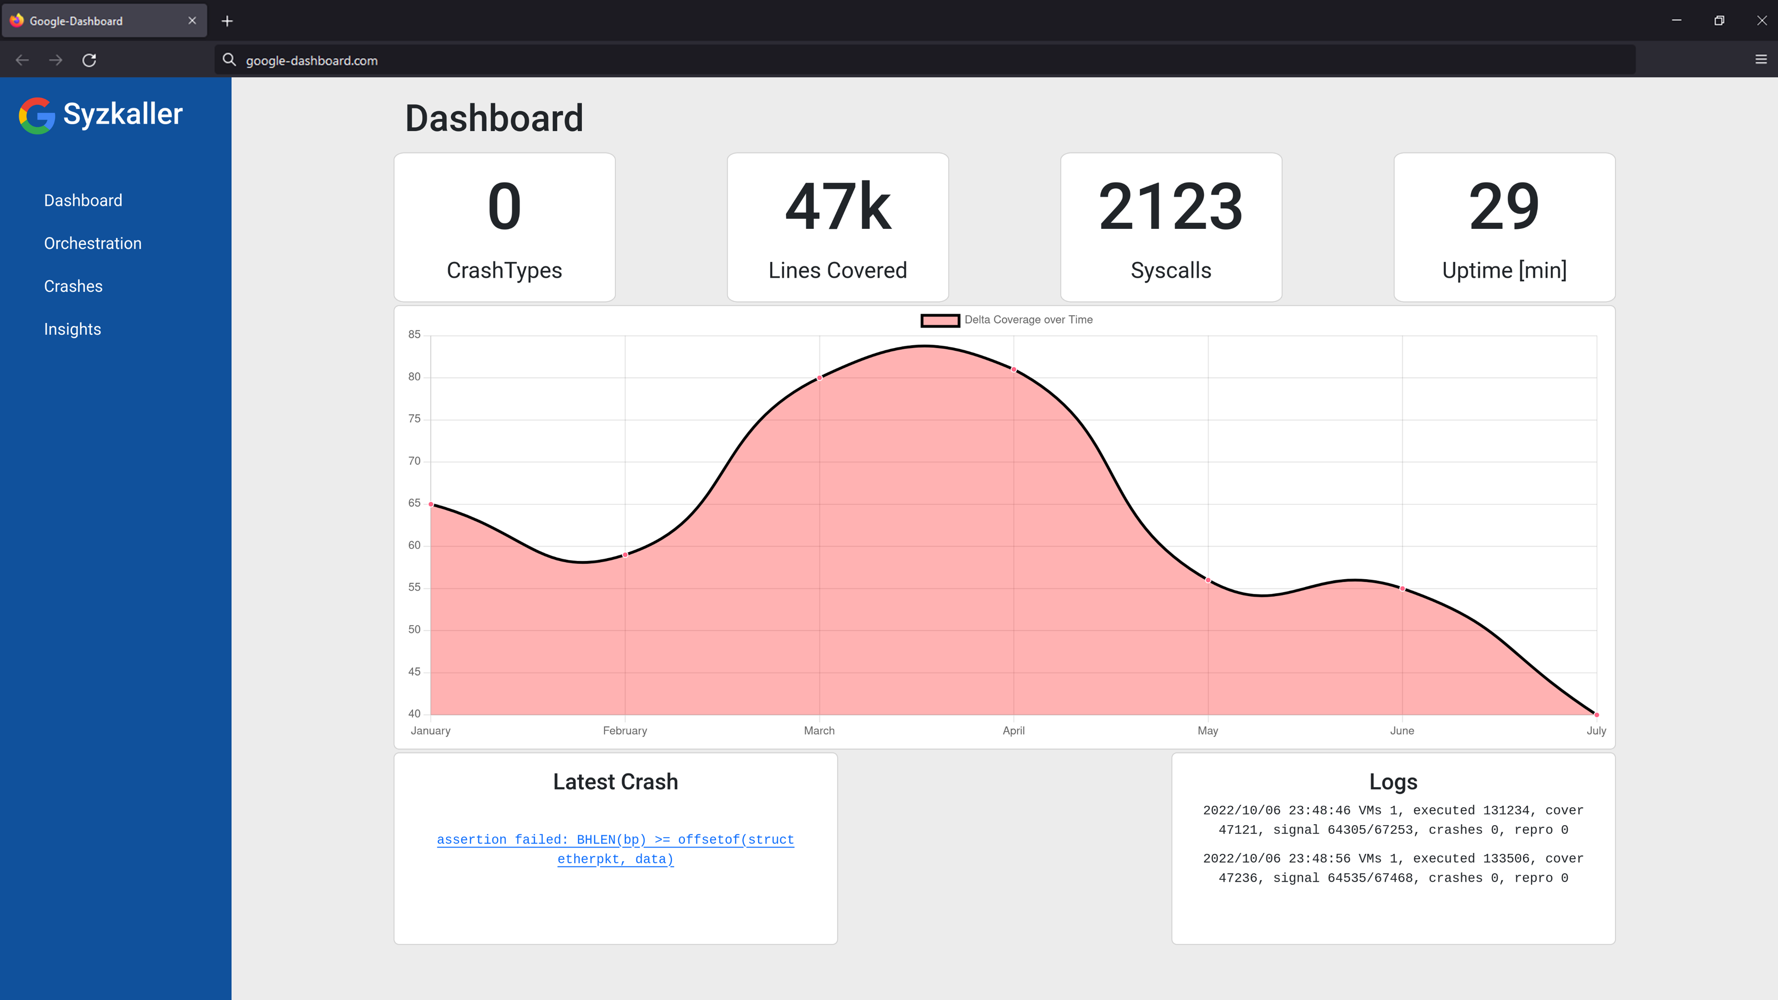
team-google-artwork-3.png

Slide 24
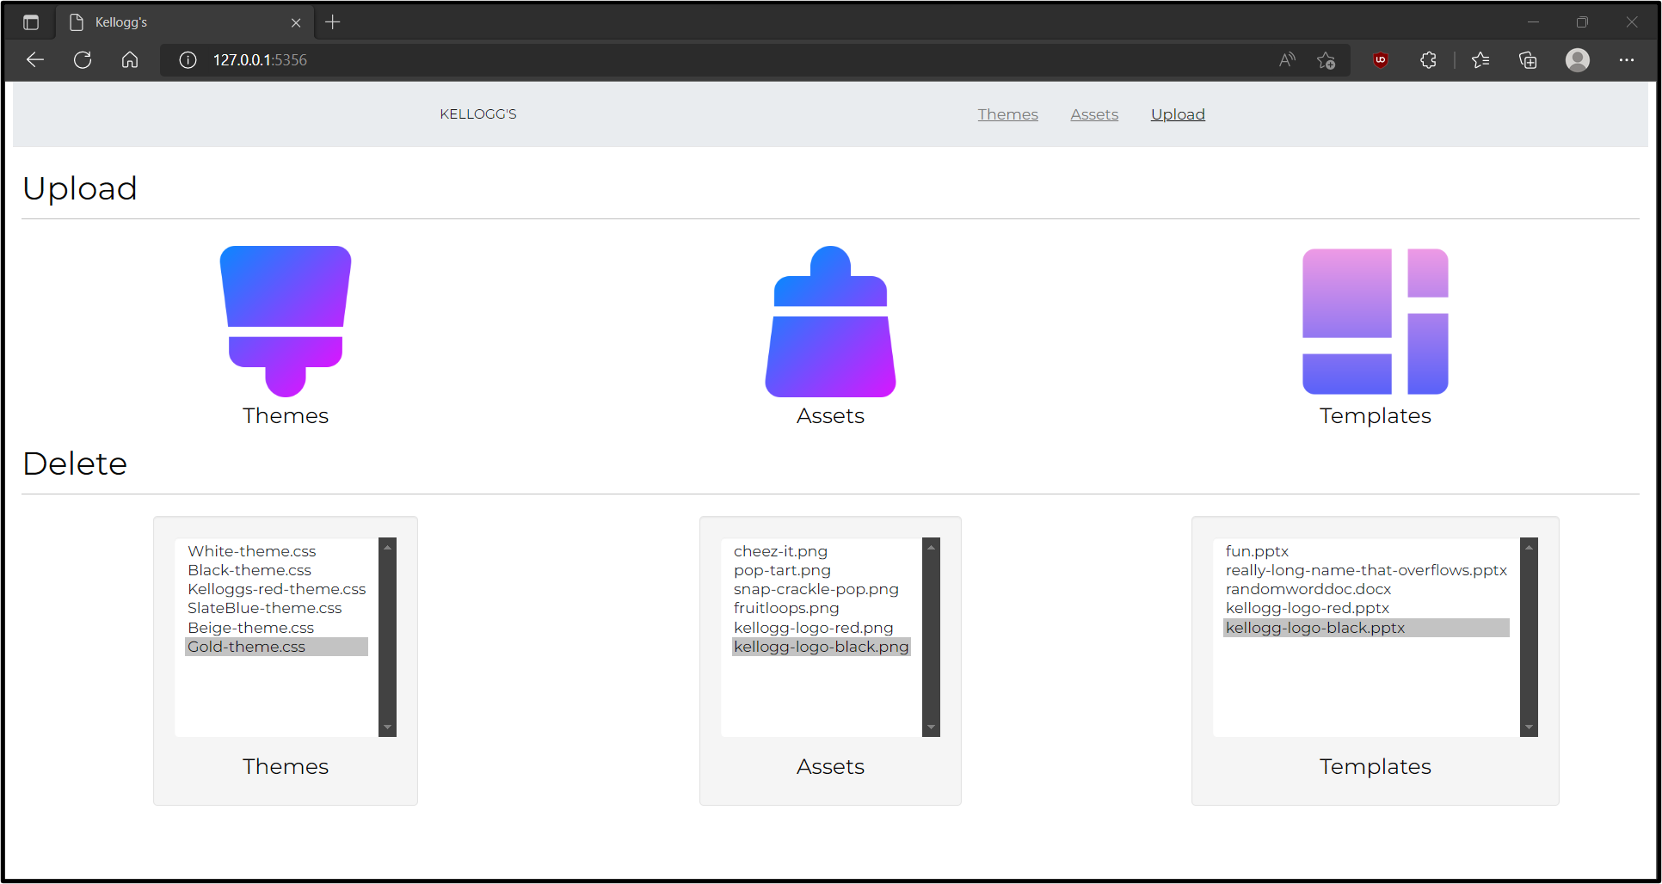
team-kelloggs-artwork-1.png

Slide 25
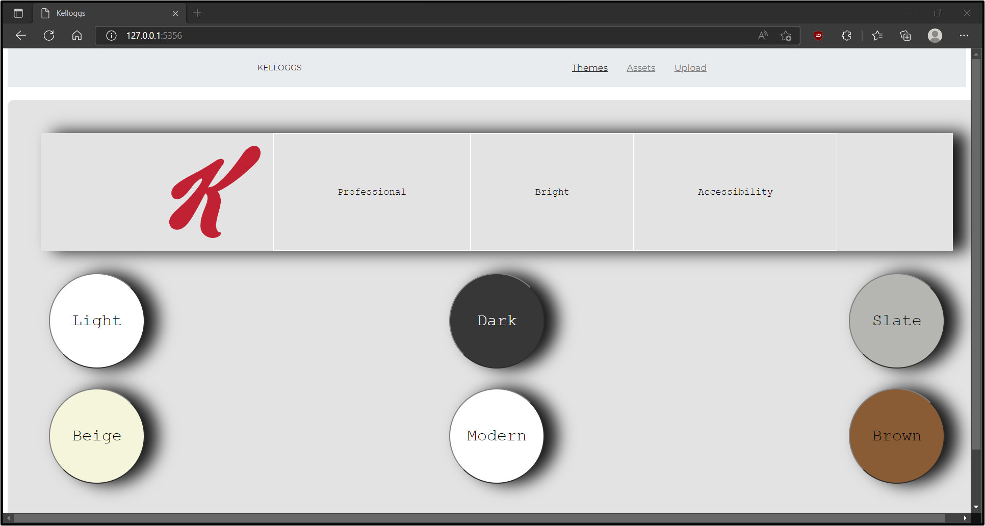
team-kelloggs-artwork-2.png

Slide 26
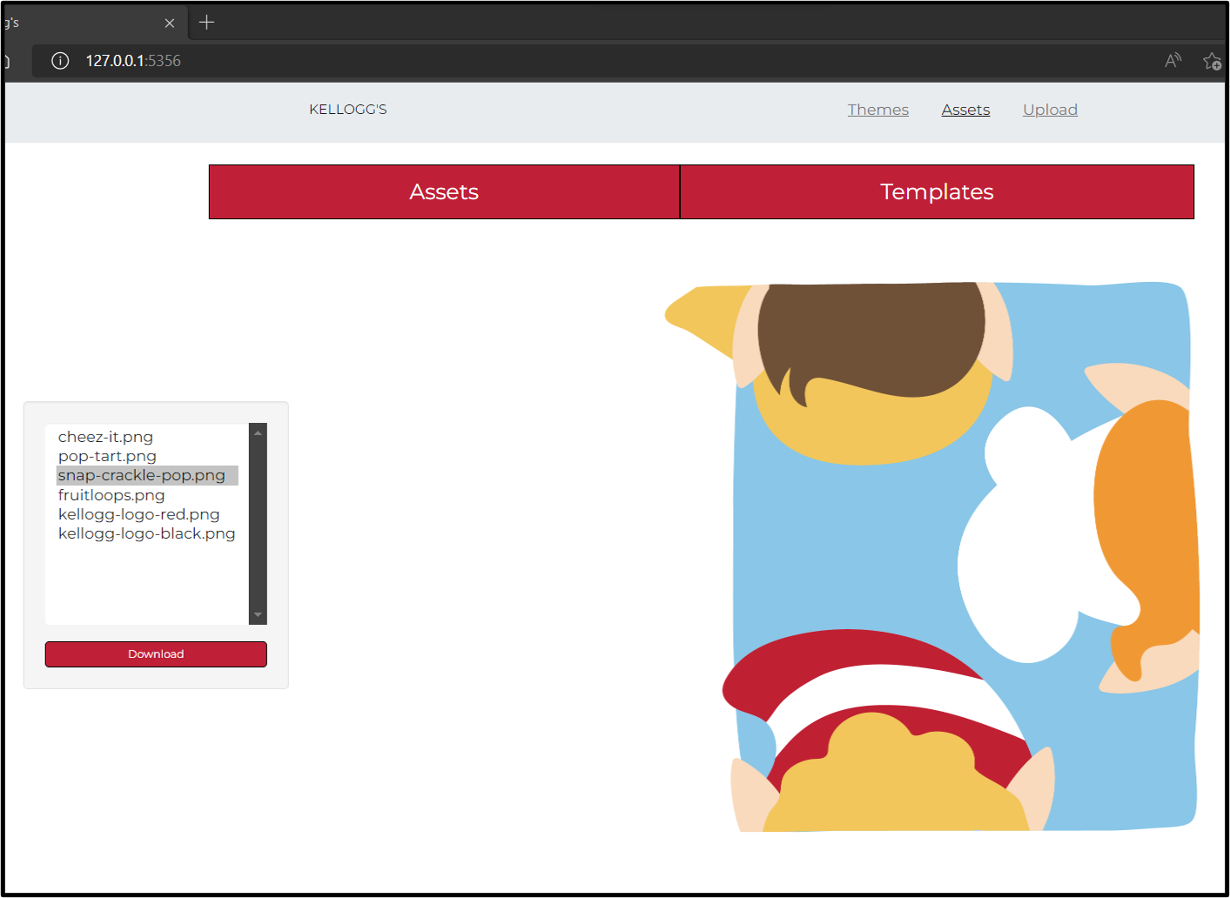
team-kelloggs-artwork-3.png

Slide 27
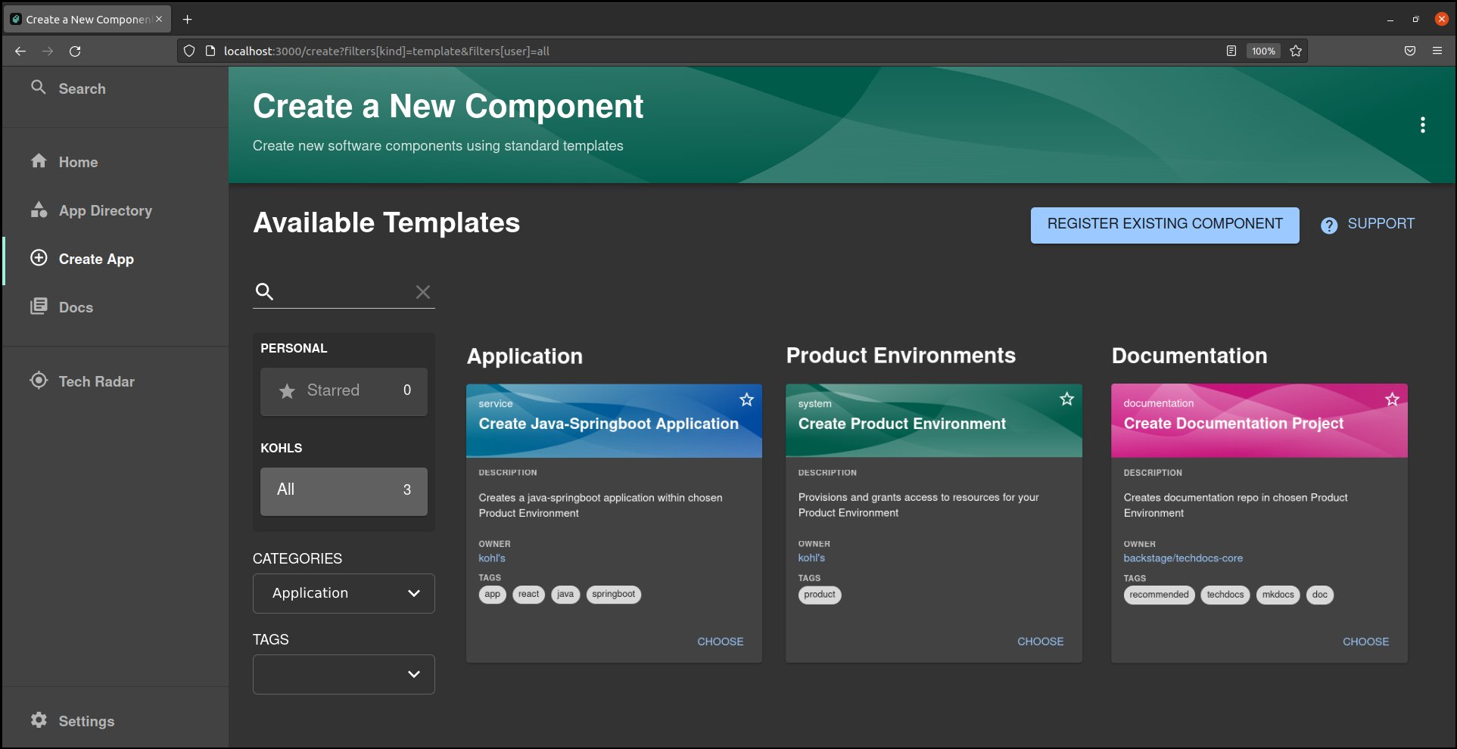
team-kohls-artwork-1.png

Slide 28
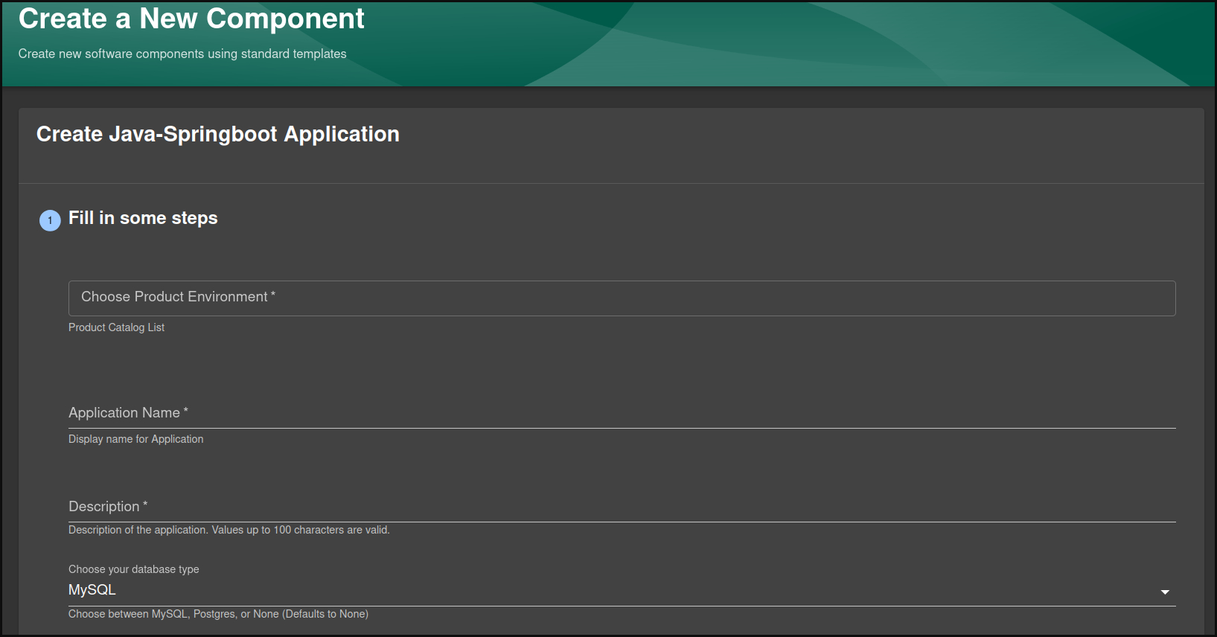
team-kohls-artwork-2.png

Slide 29
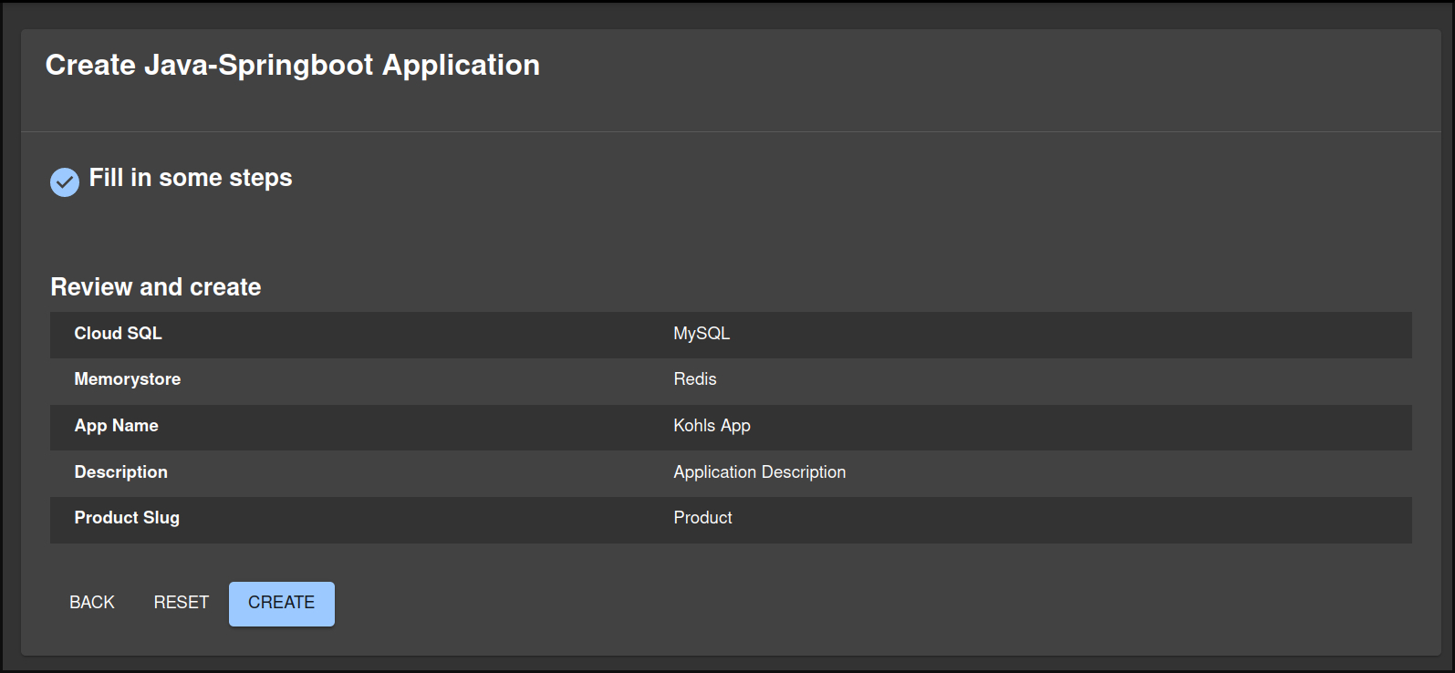
team-kohls-artwork-3.png

Slide 30
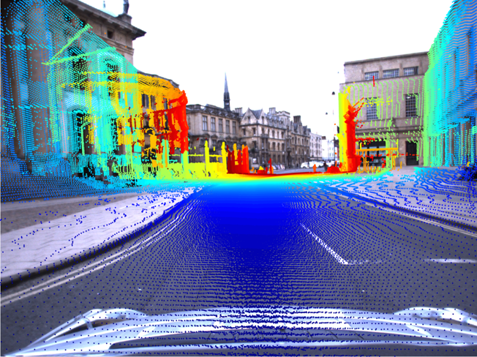
team-lockheed-martin-space-artwork-1.png

Slide 31
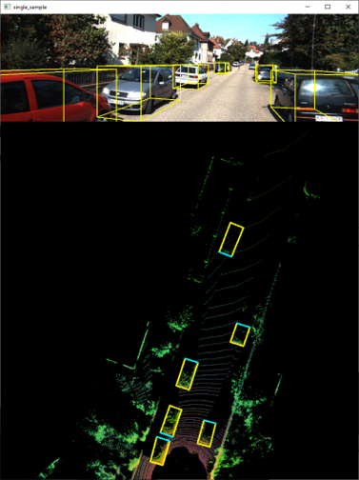
team-lockheed-martin-space-artwork-2.png

Slide 32
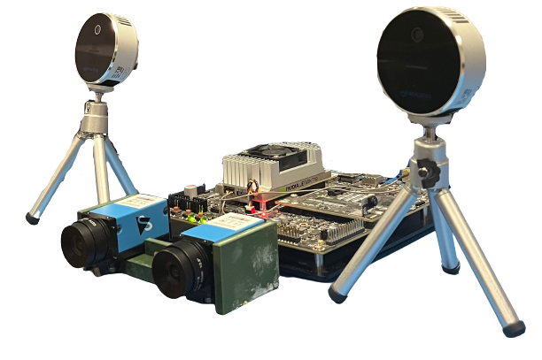
team-lockheed-martin-space-artwork-3.png

Slide 33
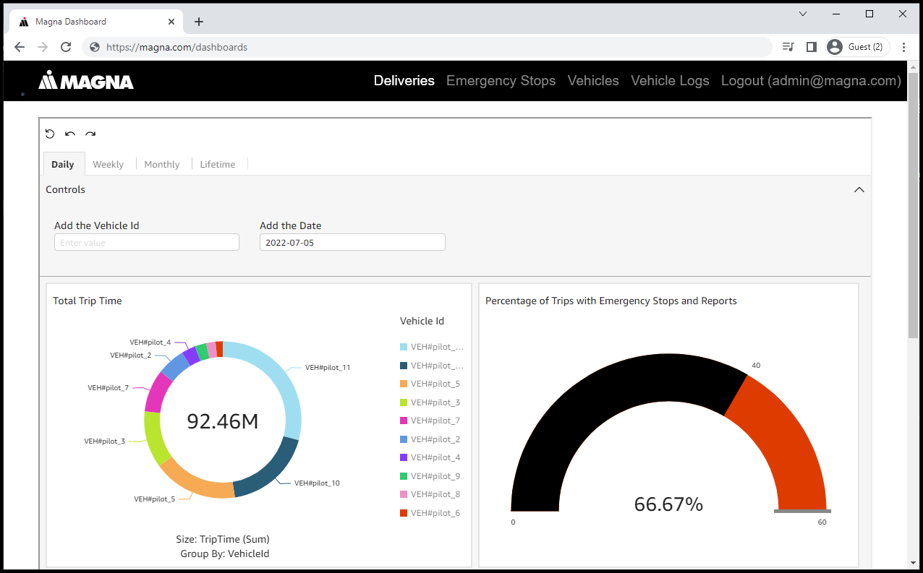
team-magna-artwork-1.png

Slide 34
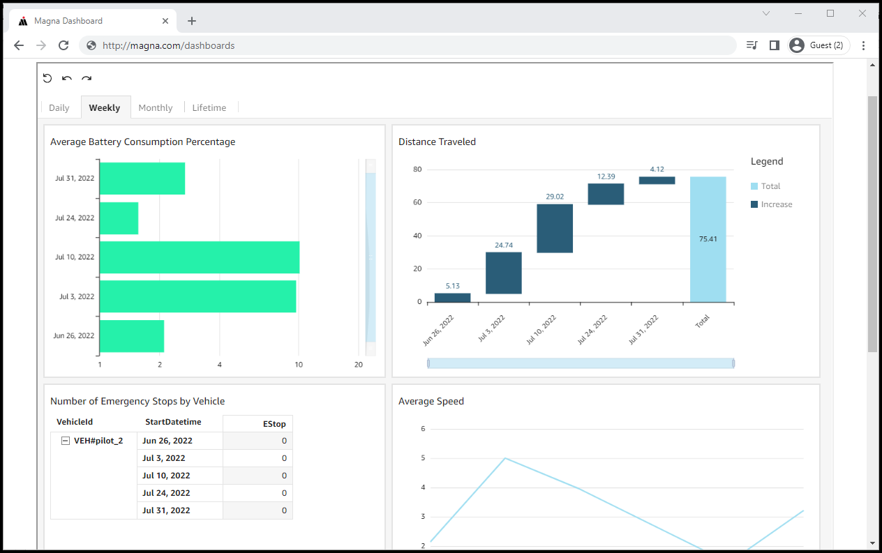
team-magna-artwork-2.png

Slide 35
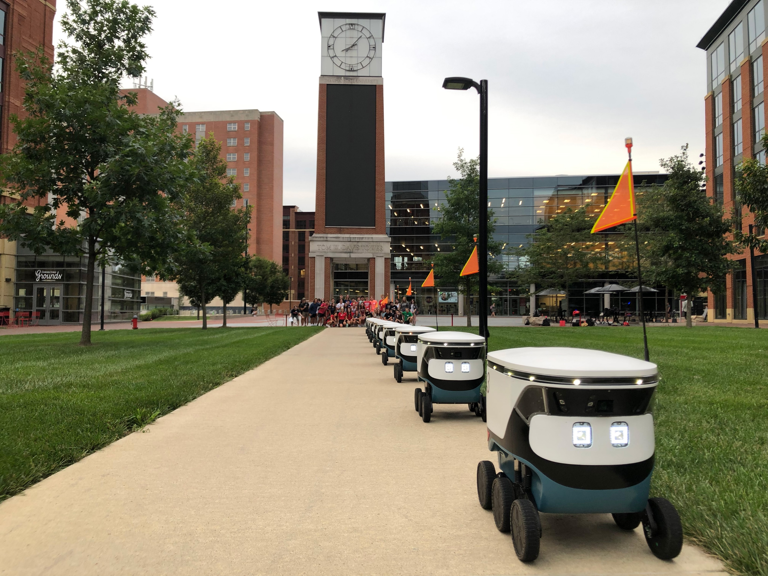
team-magna-artwork-3.png

Slide 36
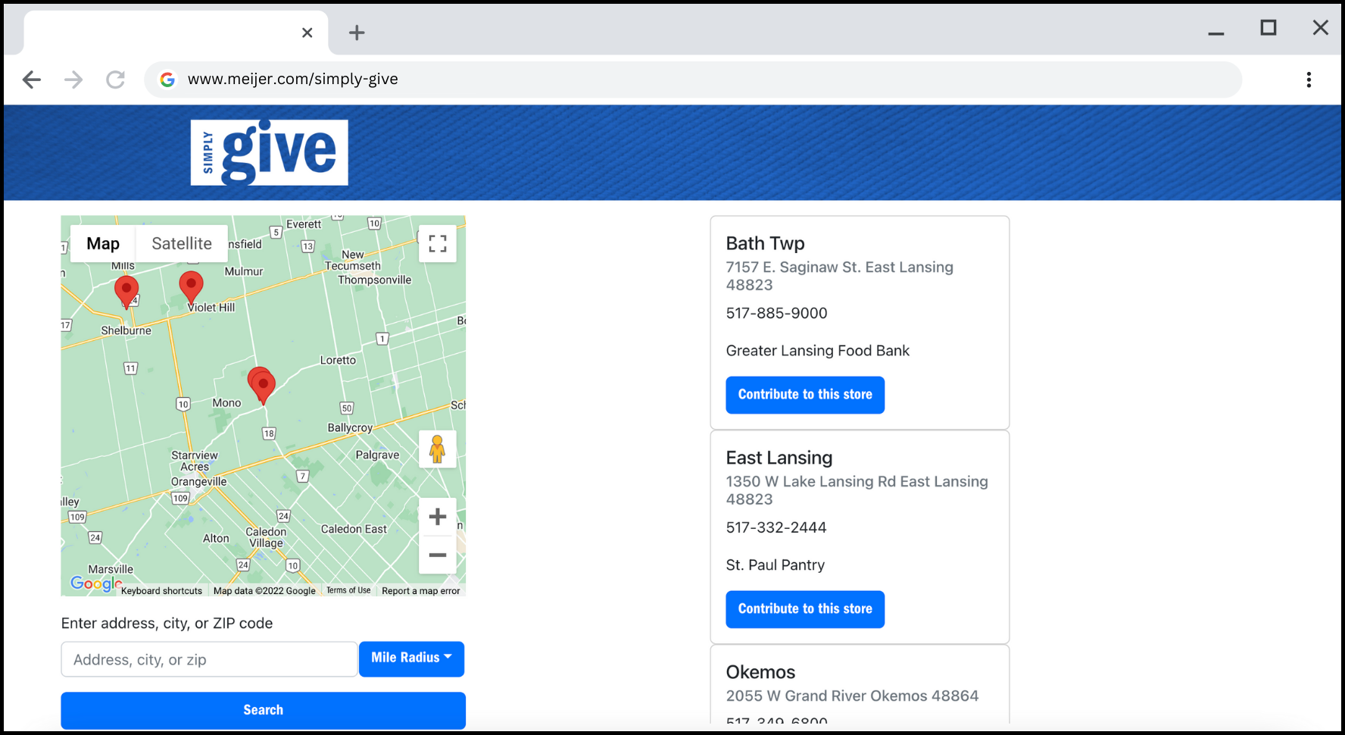
team-meijer-artwork-1.png

Slide 37
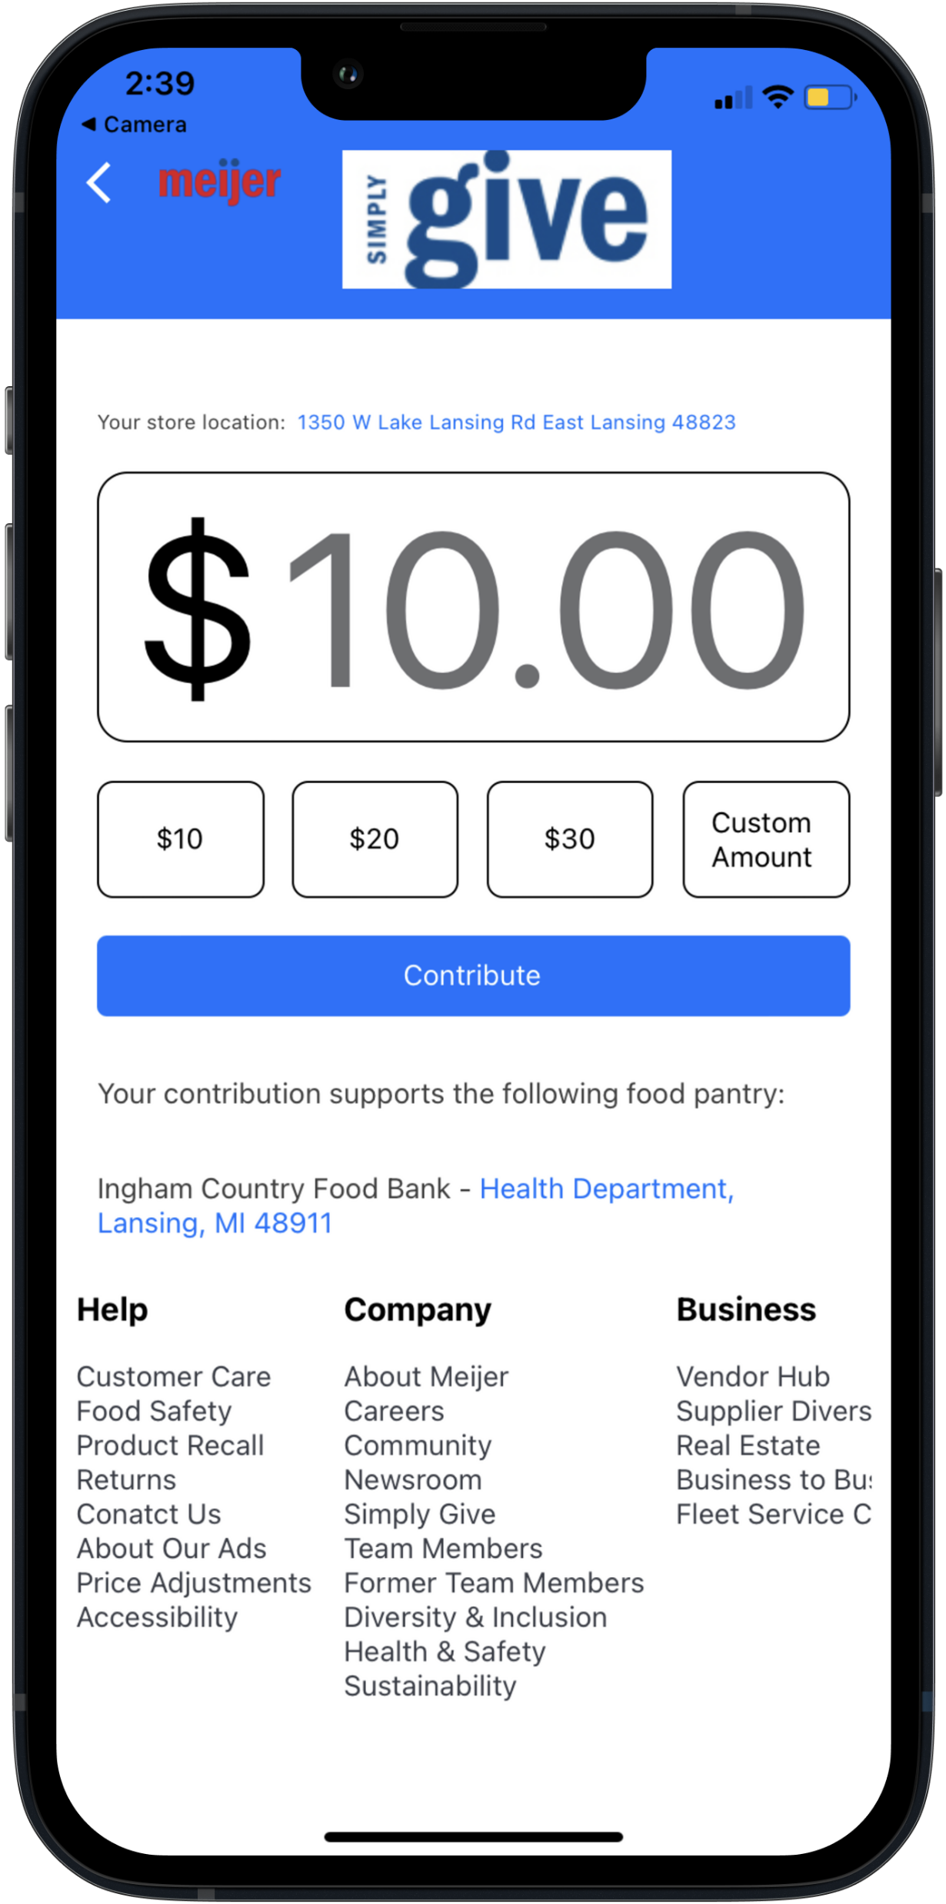
team-meijer-artwork-2.png

Slide 38
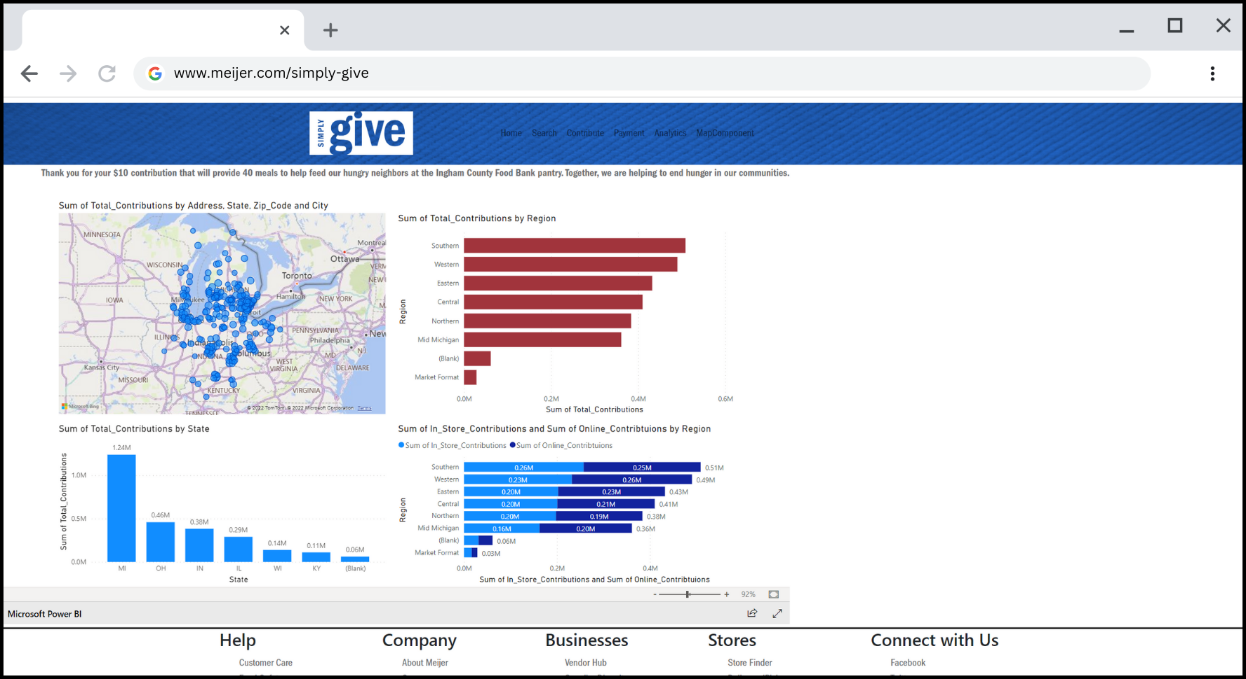
team-meijer-artwork-3.png

Slide 39
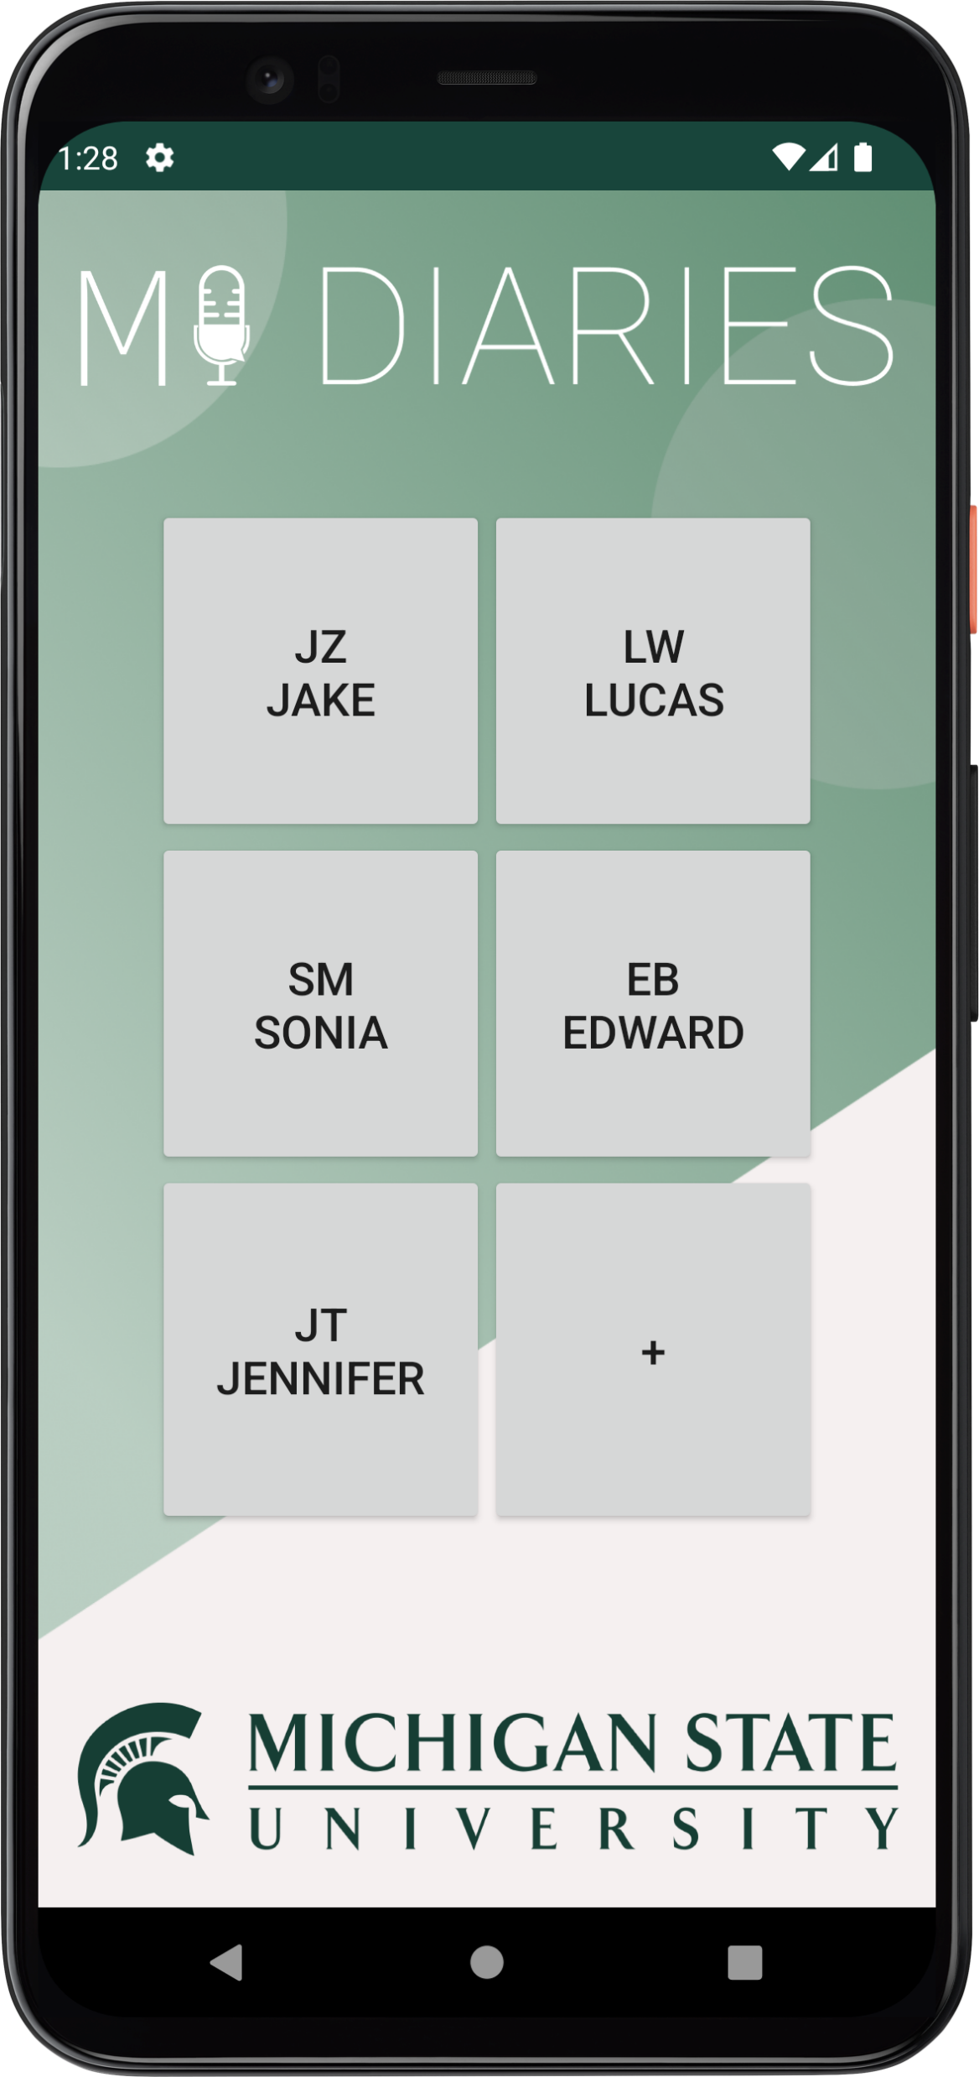
team-michigan-state-university-linguistics-artwork-1.png

Slide 40
team-michigan-state-university-linguistics-artwork-2.png

Slide 41
team-michigan-state-university-linguistics-artwork-3.png

Slide 42
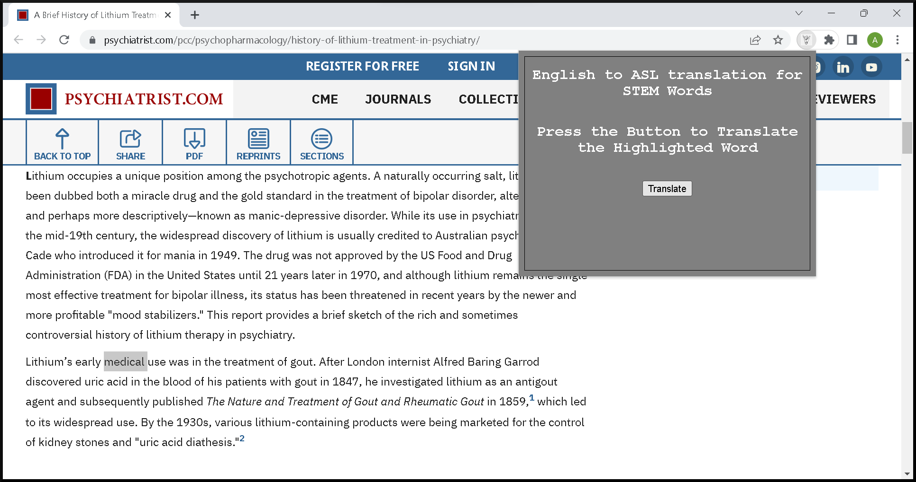
team-microsoft-artwork-1.png

Slide 43
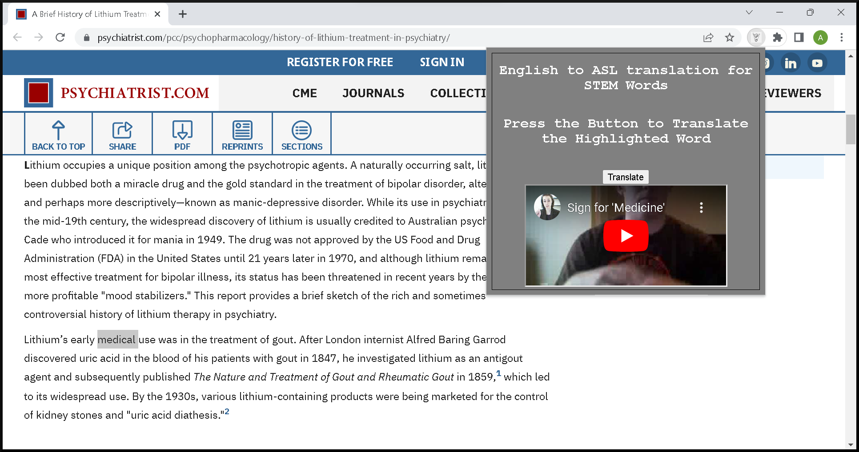
team-microsoft-artwork-2.png

Slide 44
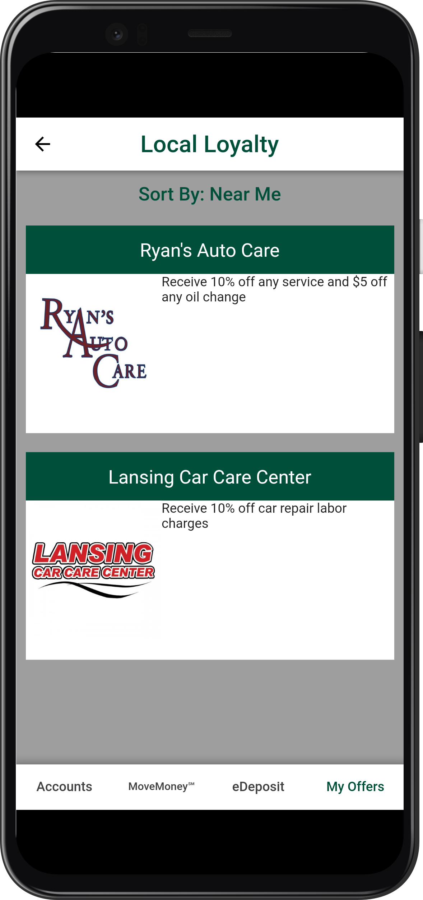
team-msufcu-artwork-1.png

Slide 45
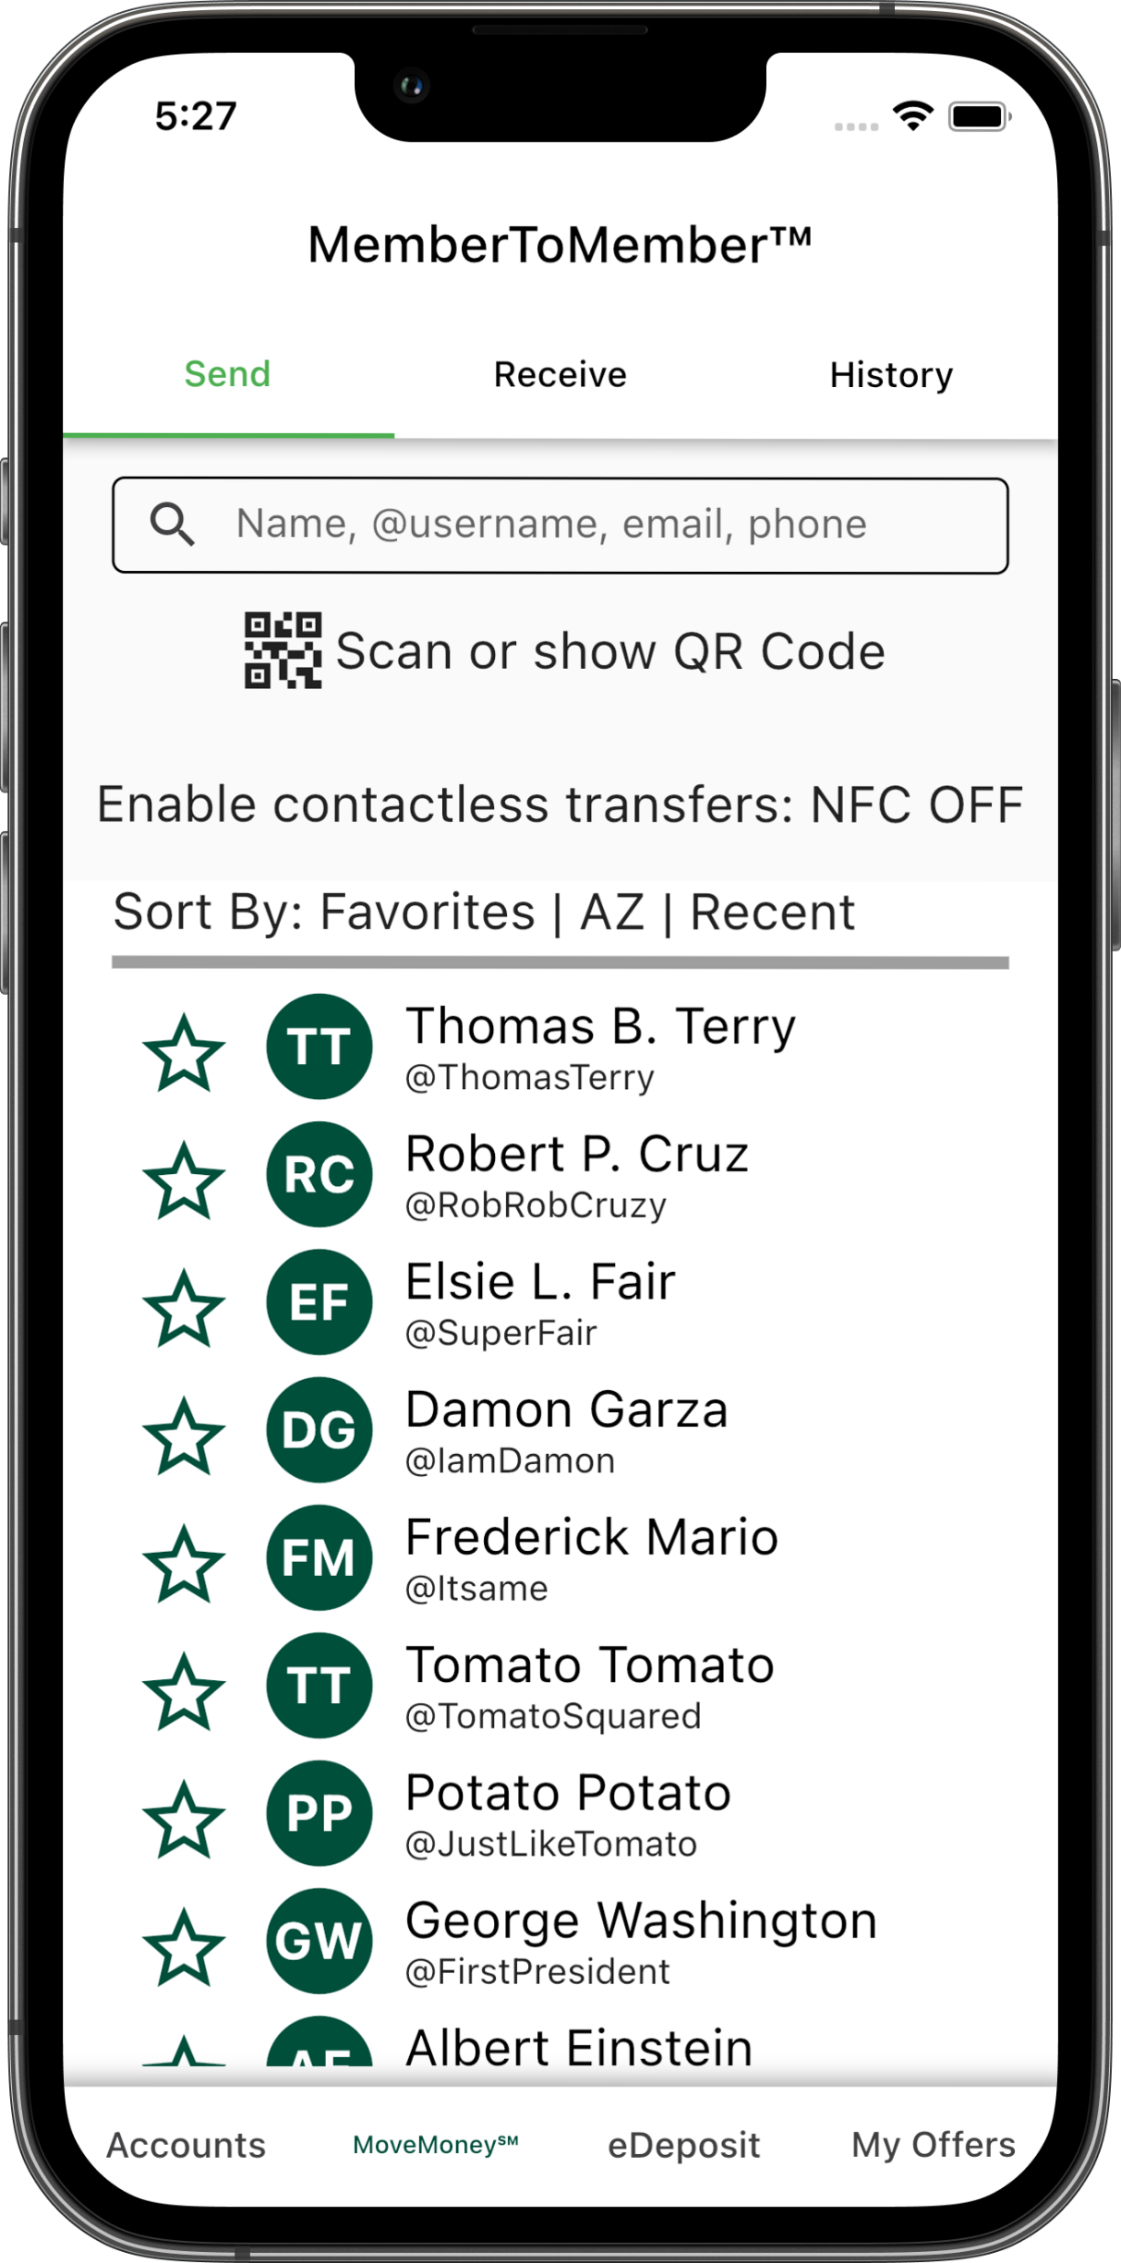
team-msufcu-artwork-2.png

Slide 46
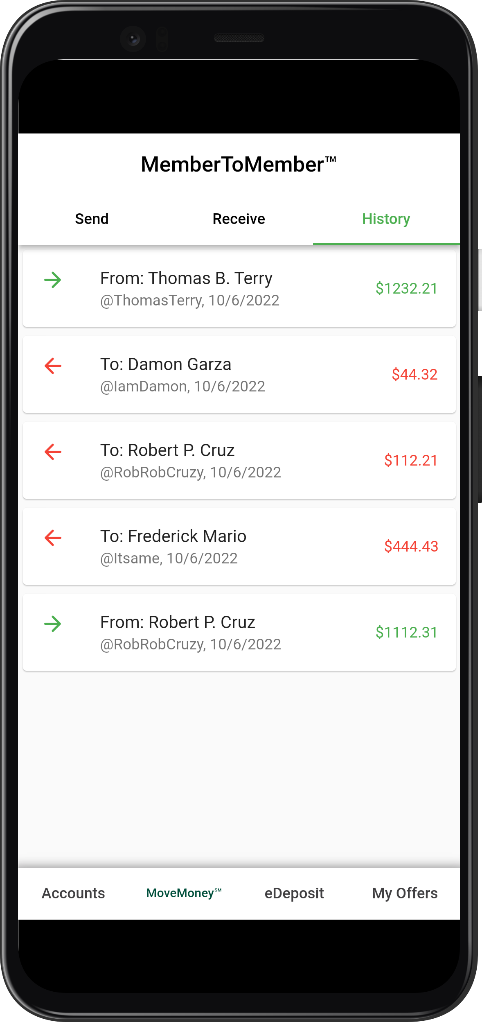
team-msufcu-artwork-3.png

Slide 47
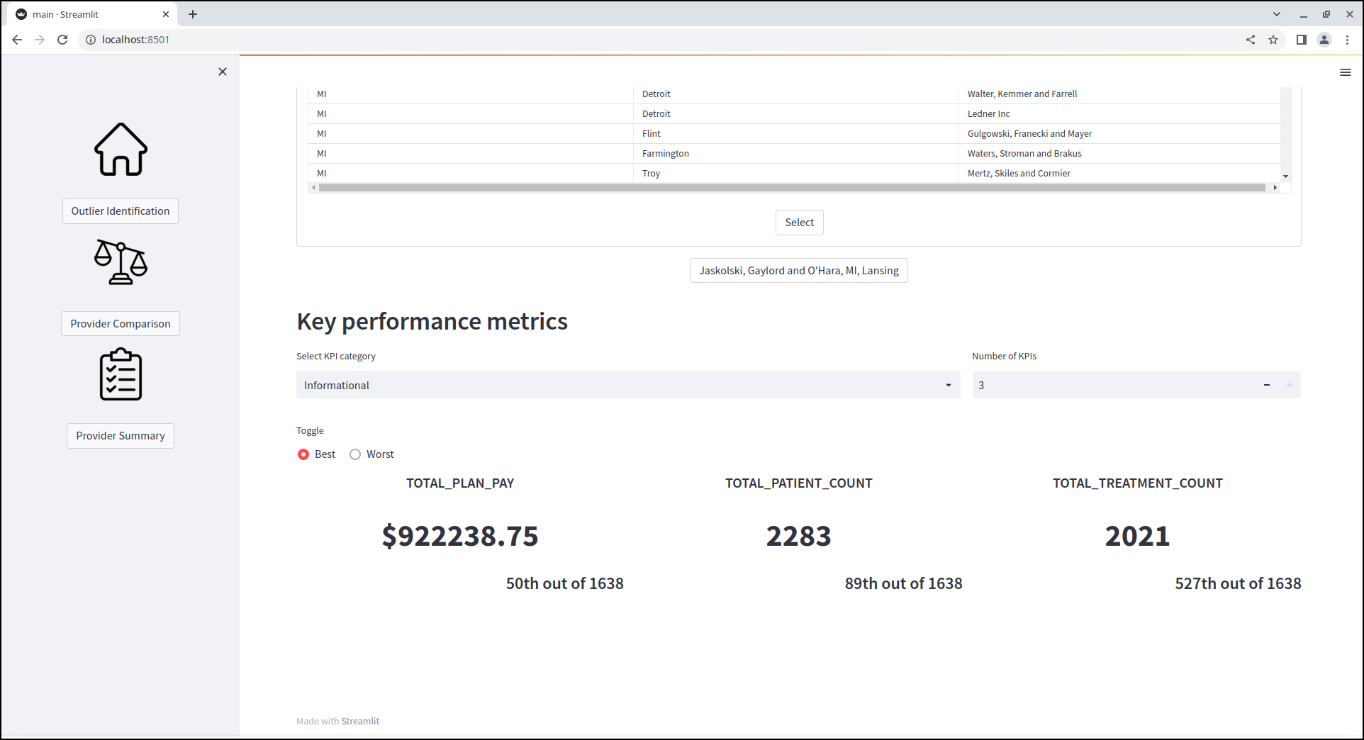
team-roosevelt-innovations-data-science-artwork-1.png

Slide 48
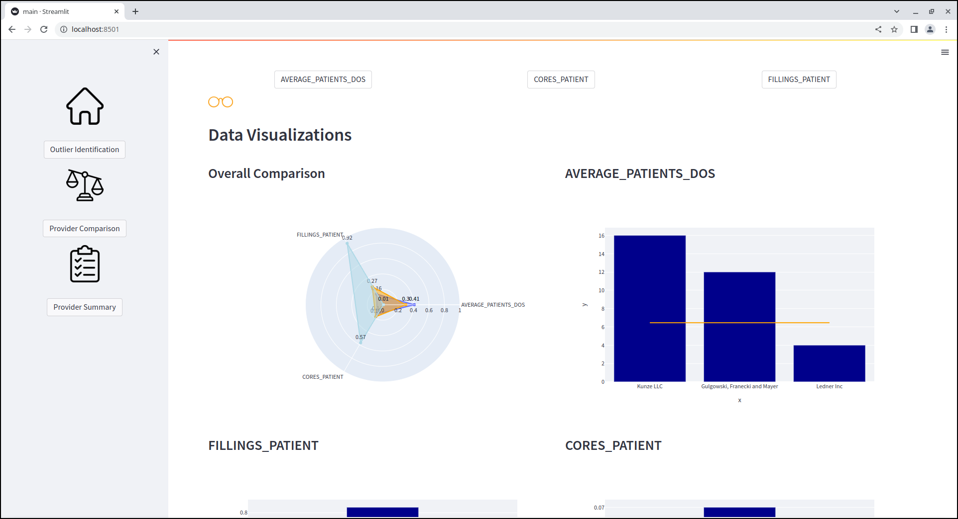
team-roosevelt-innovations-data-science-artwork-2.png

Slide 49
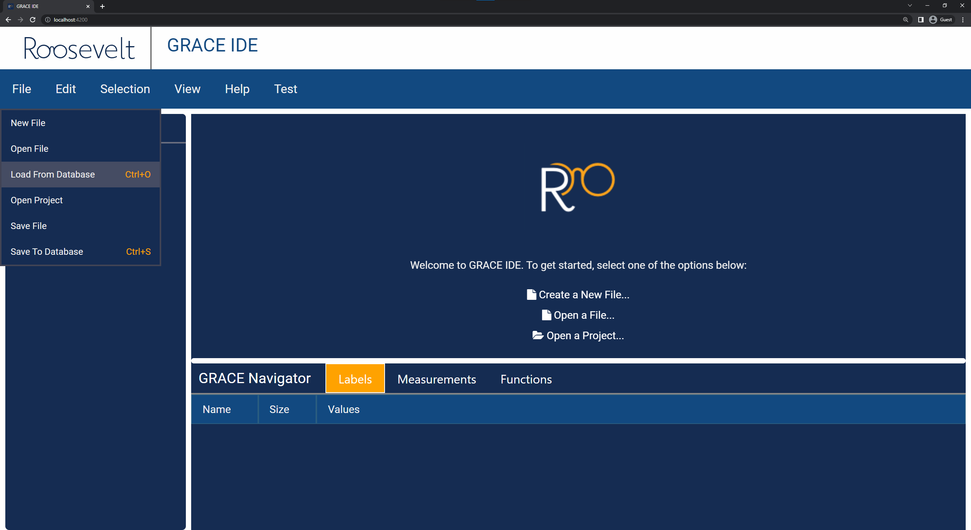
team-roosevelt-innovations-knowledge-science-artwork-1.png

Slide 50
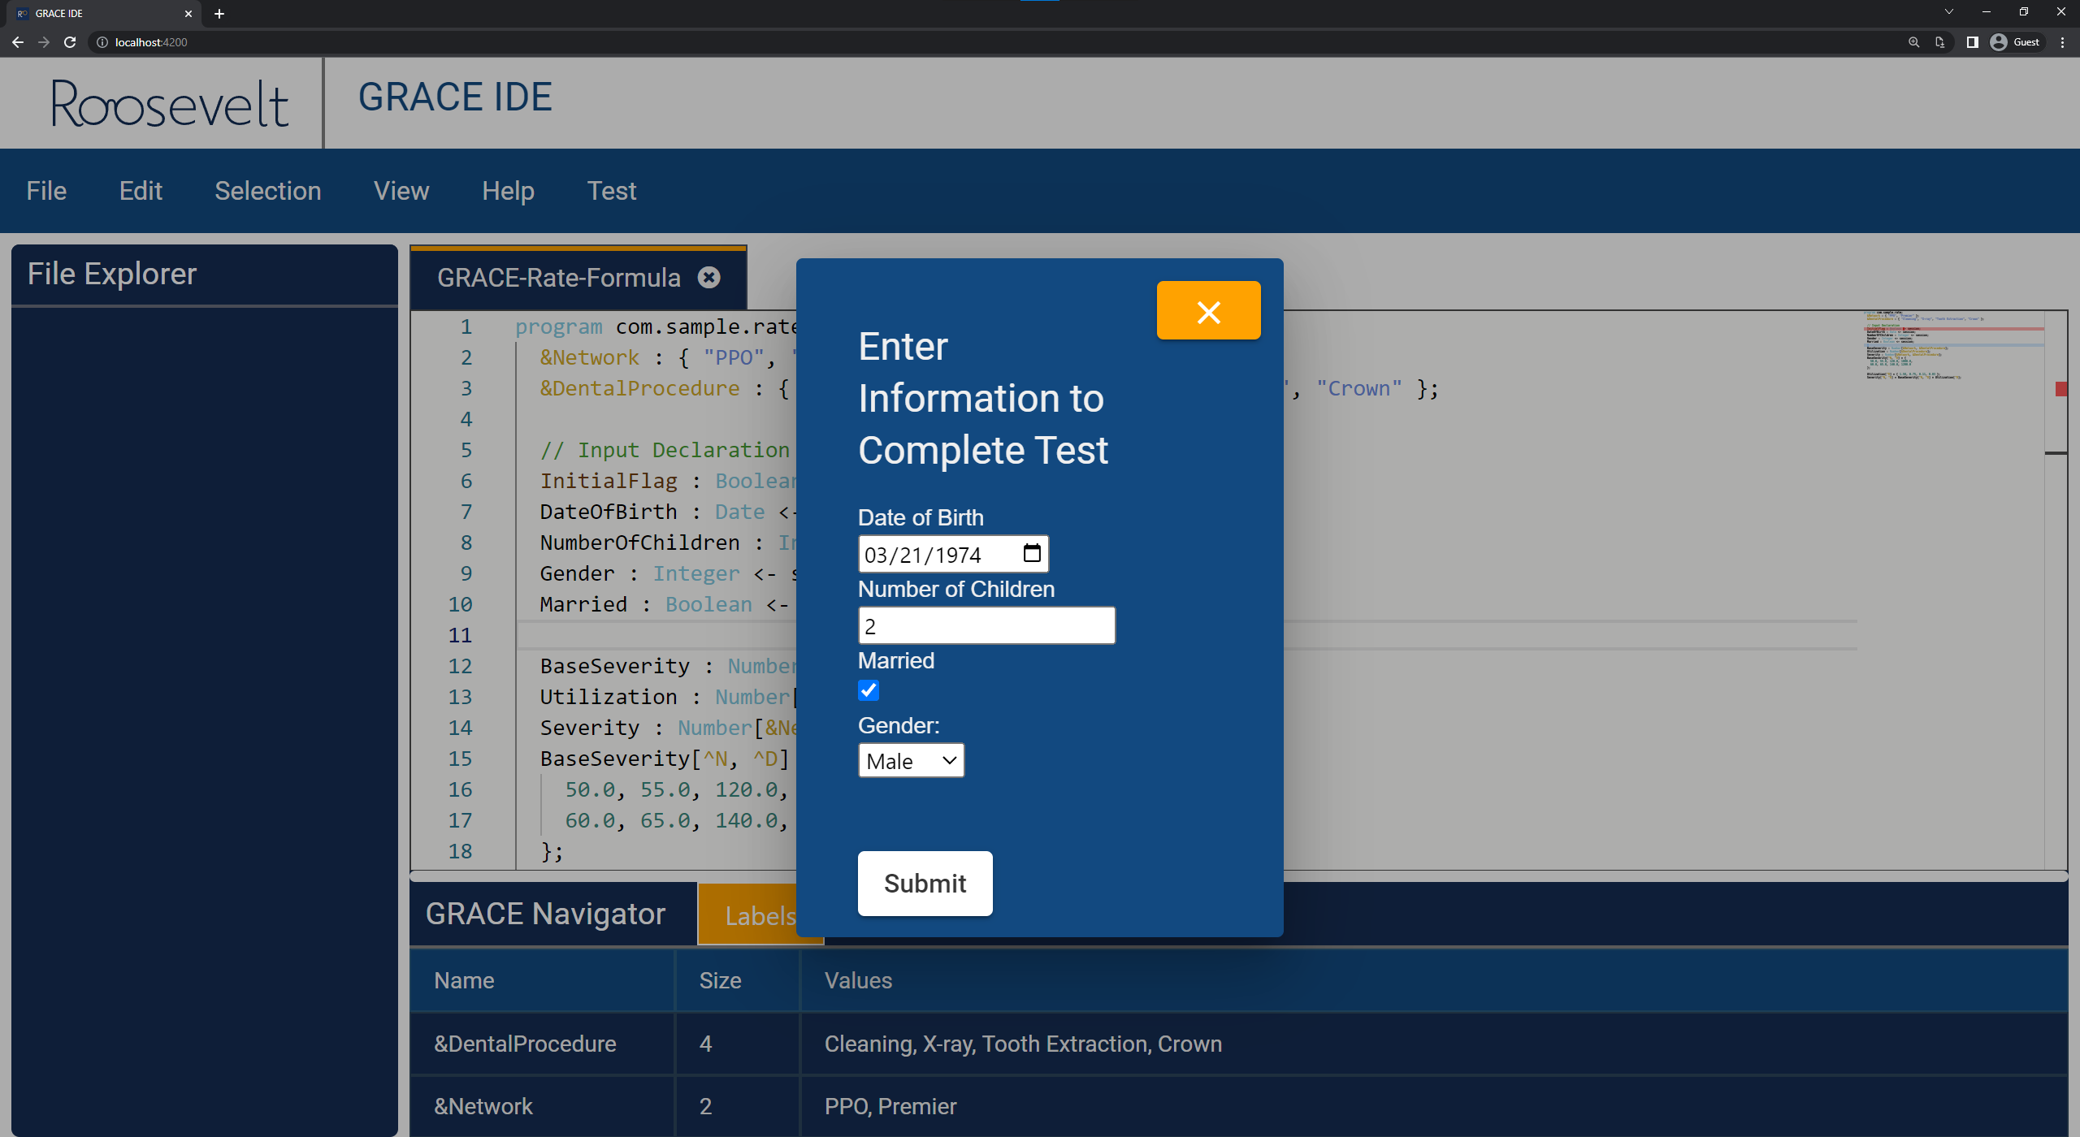
team-roosevelt-innovations-knowledge-science-artwork-2.png

Slide 51
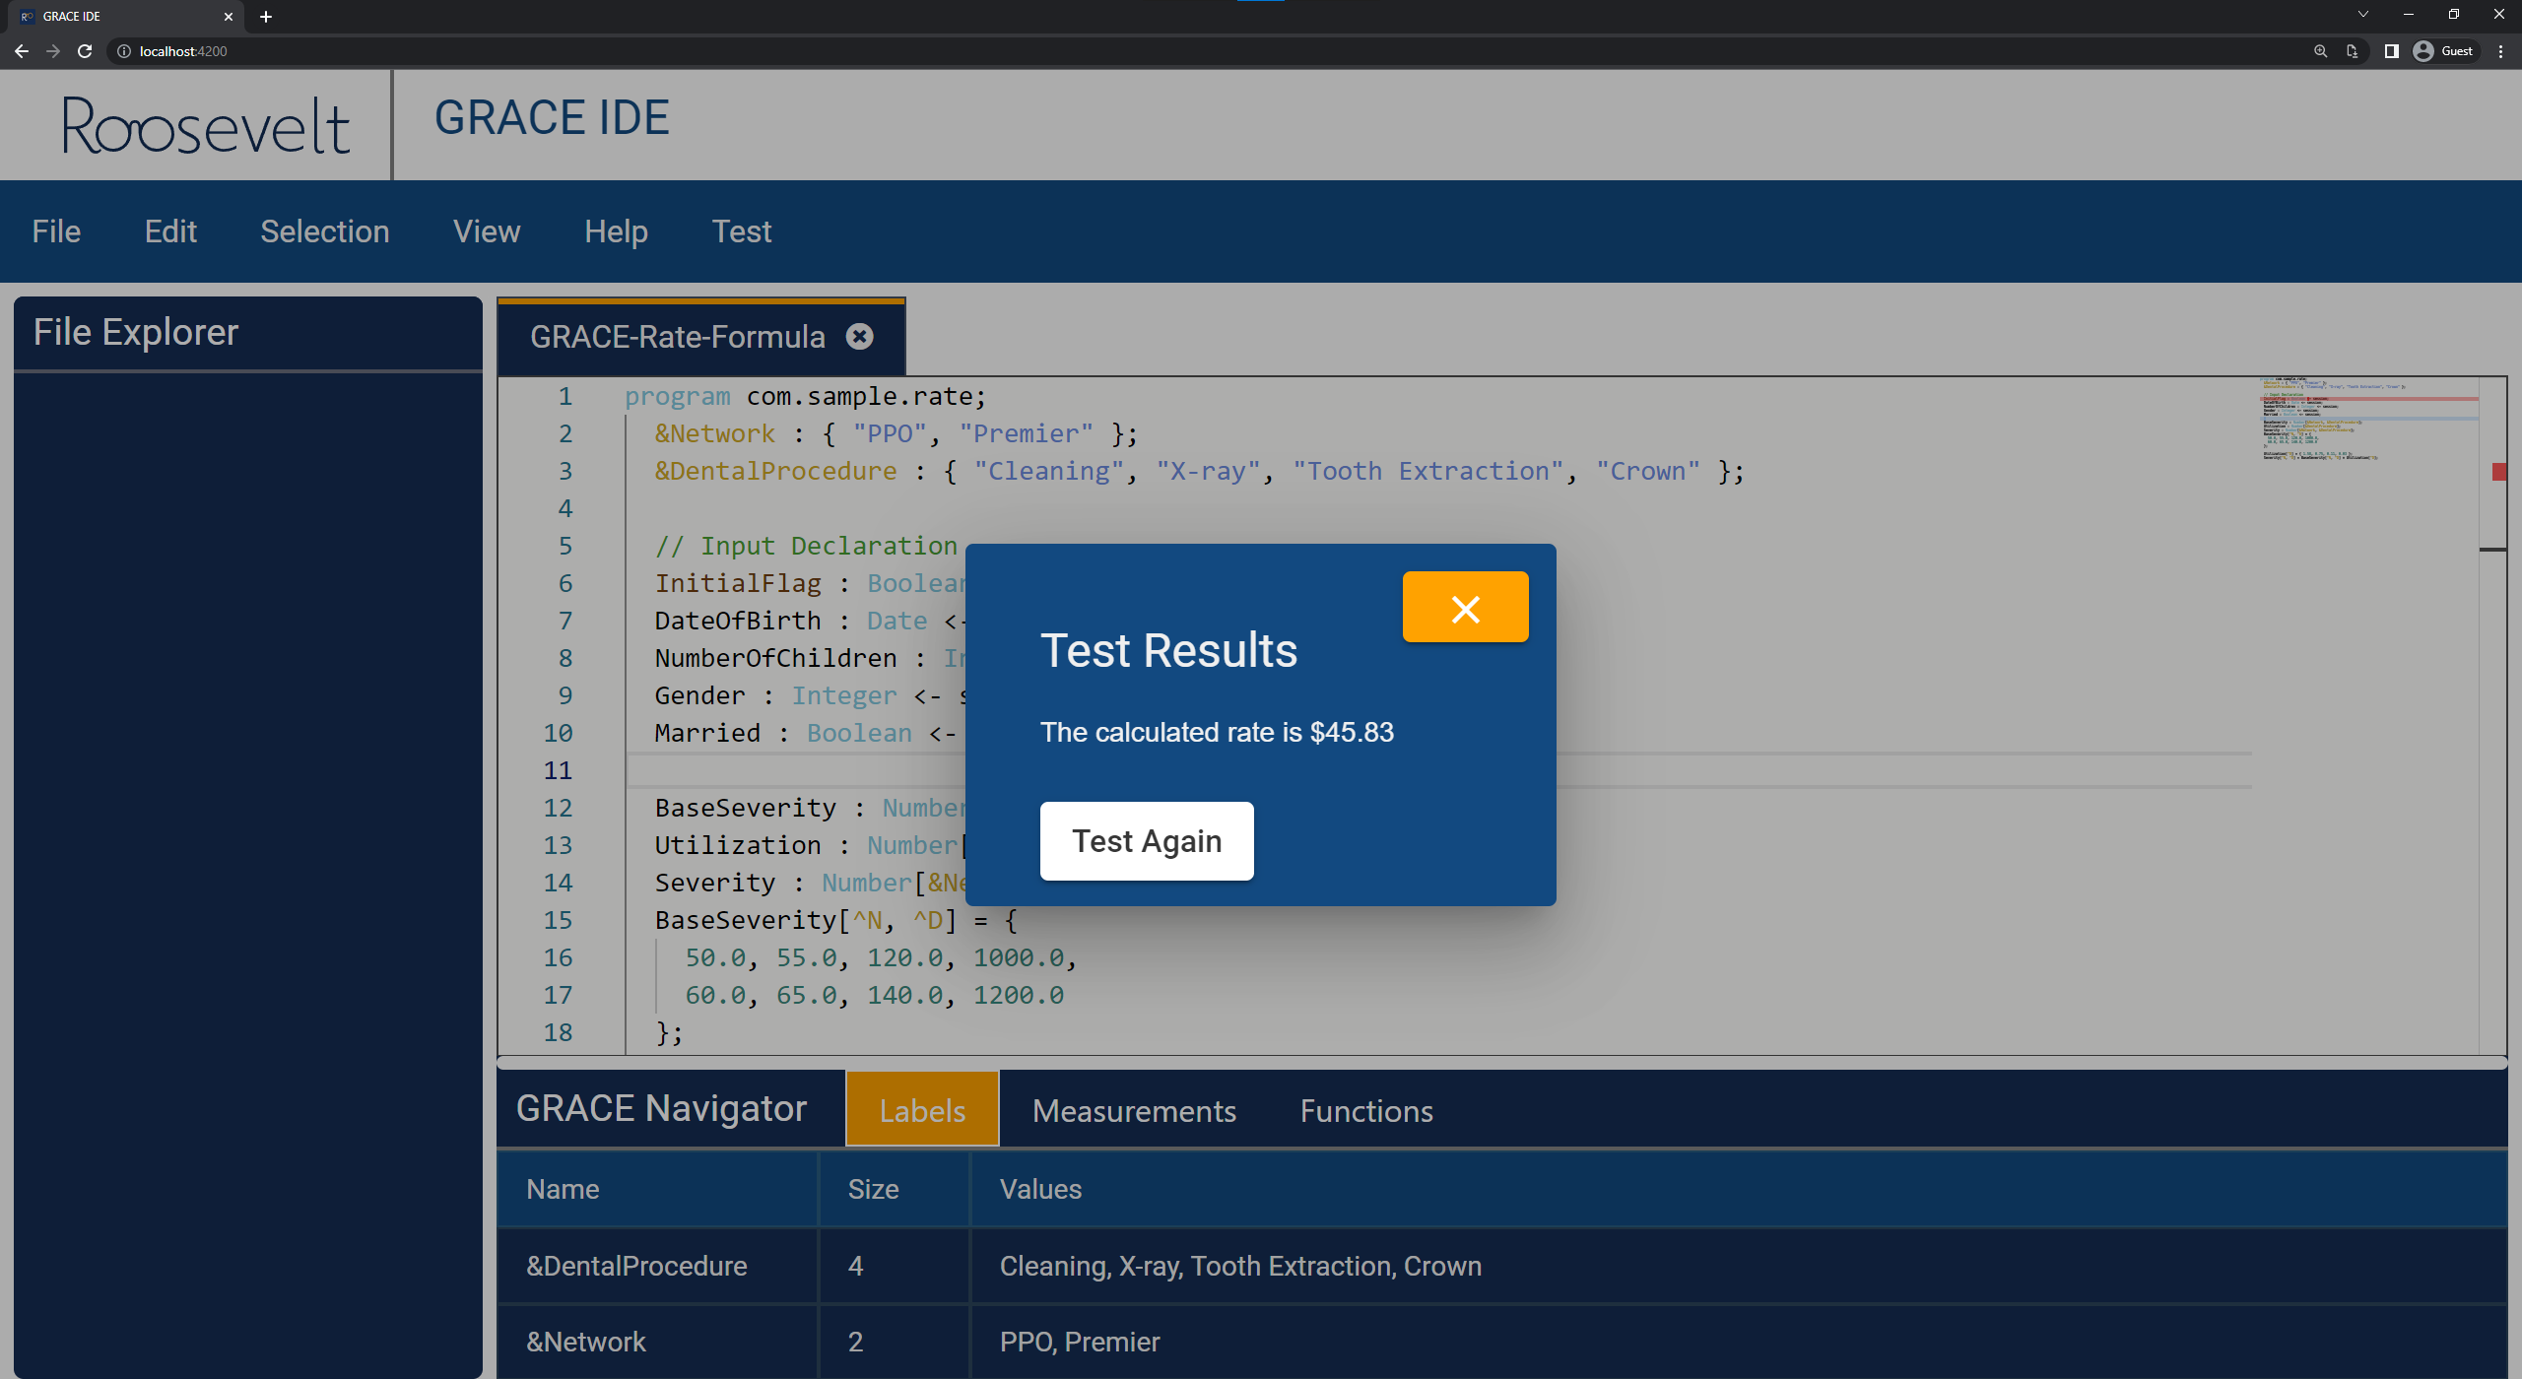
team-roosevelt-innovations-knowledge-science-artwork-3.png

Slide 52
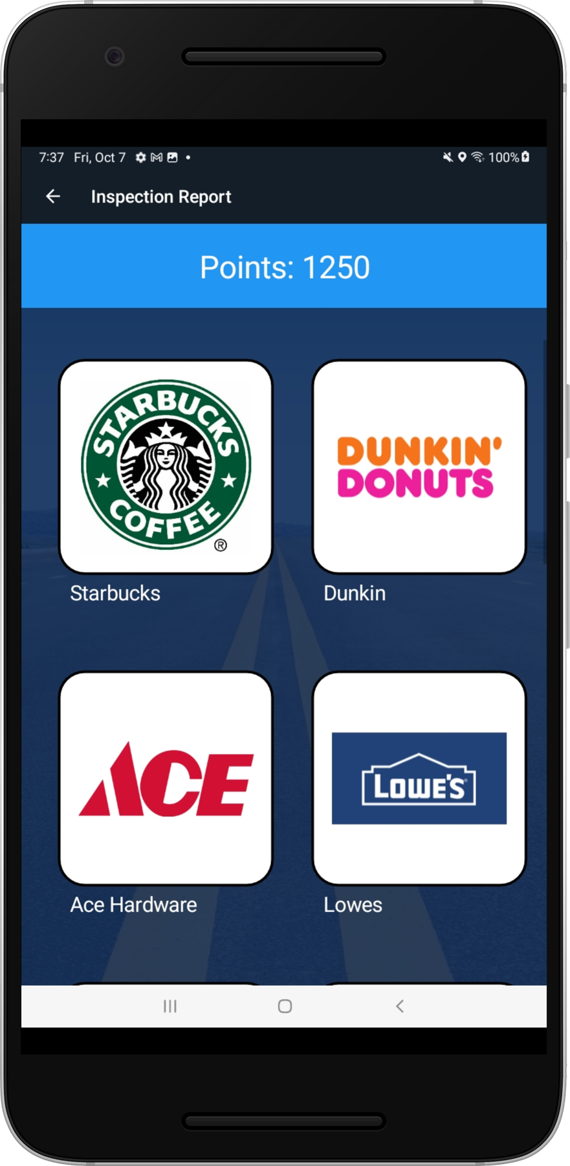
team-rpm-artwork-1.png

Slide 53
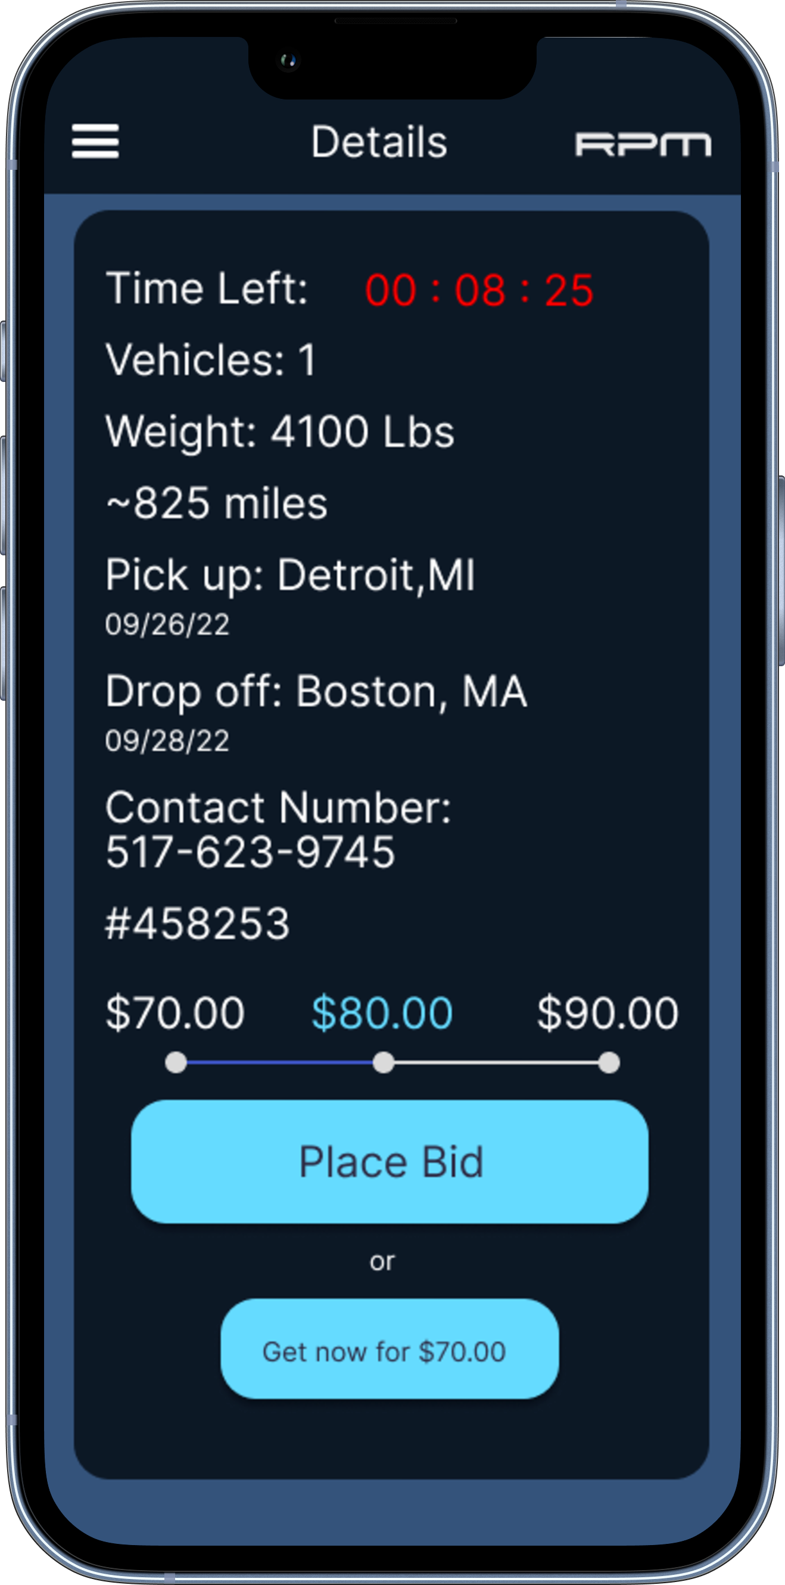
team-rpm-artwork-2.png

Slide 54
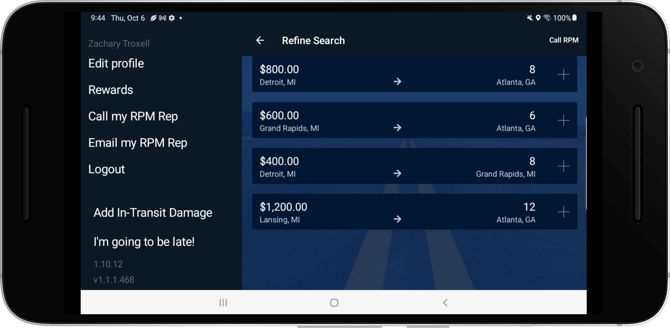
team-rpm-artwork-3.png

Slide 55
team-stryker-artwork-1.png

Slide 56
team-stryker-artwork-2.png

Slide 57
team-stryker-artwork-3.png

Slide 58
team-targets-tip-artwork-1.png

Slide 59
team-targets-tip-artwork-2.png

Slide 60
team-targets-tip-artwork-3.png

Slide 61
team-techsmith-artwork-1.png

Slide 62
team-techsmith-artwork-2.png

Slide 63
team-techsmith-artwork-3.png

Slide 64
team-union-pacific-artwork-1.png

Slide 65
team-union-pacific-artwork-2.png

Slide 66
team-united-airlines-airport-operations-artwork-1.png

Slide 67
team-united-airlines-airport-operations-artwork-2.png

Slide 68
team-united-airlines-airport-operations-artwork-3.png

Slide 69
team-united-airlines-quality-assurance-artwork-1.png

Slide 70
team-united-airlines-quality-assurance-artwork-2.png

Slide 71
team-united-airlines-quality-assurance-artwork-3.png

Slide 72
team-united-airlines-quality-assurance-artwork-4.png

Slide 73
team-united-airlines-training-artwork-1.png

Slide 74
team-united-airlines-training-artwork-2.png

Slide 75
team-united-airlines-training-artwork-3.png

Slide 76
team-urban-science-artwork-1.png

Slide 77
team-urban-science-artwork-2.png

Slide 78
team-vectorform-artwork-1.png

Slide 79
team-vectorform-artwork-2.png

Slide 80
team-vectorform-artwork-3.png

Slide 81
team-vectorform-artwork-4.png

Slide 82
team-volkswagen-artwork-1.png

Slide 83
team-volkswagen-artwork-2.png

Slide 84
team-volkswagen-artwork-3.png

Slide 85
team-whirlpool-artwork-1.png

Slide 86
team-whirlpool-artwork-2.png

Slide 87
team-whirlpool-artwork-3.png

Slide 88
team-whirlpool-artwork-4.png

