Slide 1
Read Me (Delete this slide.) [1 of 2]
Presenting
  The purpose of the project plan presentation is to convince everyone that your team has scoped your project, understands the functional, design, and technical specifications, and that your team has a crafted plan to develop, debug, and deliver your project to your client on time (December 7, 2016) and on budget ($0).
  The time limit for your presentation is 15 minutes, which will be strictly enforced. Practice your presentation to ensure that you will finish within the allotted time.
  All team members are required to dress business casual on the day of your presentation. Business casual does not include sneakers, hats, coats, hoodies, or t-shirts. Google “what is business casual.”
  “Formal” team photos of the presenting teams will be taken in the Capstone Lab immediately following these all-hands meetings. Plan on it.

Slide 2
Read Me (Delete this slide.) [2 of 2]
Content
  Do not include any company confidential information in your presentation since all presentations will be posted on the web site.
  Submit your presentation to your client for approval at least two working days in advance.
  Throughout the PowerPoint template, replace placeholders <…> with the appropriate information.
  Edit the center footer by clicking the Header & Footer button on the Insert ribbon. Change <Company Name> in the footer to your company name as in “Team GM Project Plan”.
  Delete the example Screen Mockups and System Architecture slides and this Read Me slide from your presentation.
    The screen mockups should not contain any bordering transparent or whitespace. Use paint.net to crop them appropriately.
    If a slide contains more than one screen shot or additional artwork (like an arrow), group all of the items into a single grouping so that it can be copied-and-pasted and resized as a single unit
Required Template
  Do not edit the Slide Masters.
  Do not change the organization of slides.
Submission
  Although the presentations are scheduled over the course of four meetings, all teams must be prepared to present on the first day scheduled, Monday, January 31.
  The order of the presentations will be posted on our All-Hands Meetings page in the evening of the day before the first day scheduled for presentations.
  Email your presentation to Dr. D. by 4:00 a.m. on Monday, January 31. (Think Sunday night.)
  For subject, use “Team <Company Name>: Beta Presentation” as in “Team Amazon: Project Plan Presentation”.
  Attach the PowerPoint source file named “team-<company-name>-beta-presentation.ppt” as in “team-urban-science-project-plan-presentation.ppt”.

Slide 3
Project Plan
<Project Title 36pt>
Team <Company Name 24pt>
<Team Member 1 16pt>
<Team Member 2 16pt>
<Team Member 3 16pt>
<Team Member 4 16pt>
<Team Member 5 16pt>
Department of Computer Science and Engineering
Michigan State University
Spring 2017

Slide 4
Functional Specifications
Point 1
Point 2
Point 3
Etc…
This is your project overview.
Describe what problem your project solves.
Answer the question “What does your project do?”
This is your “elevator pitch”.
DELETE THIS TEXT BOX.

Slide 5
Design Specifications
Point 1
Point 2
Point 3
Etc…
Articulate a summary of your project’s major features as well as its overall design.
DELETE THIS TEXT BOX.

Slide 6
Screen Mockup: <Title>
You may include as many screen mockups as you have like, but you must include at least two examples.
To include more than two, you can duplicate this slide as many times as necessary.
Give each mockup slide a title.
See below for examples and instructions.
DELETE THIS TEXT BOX.

Slide 7
Screen Mockup: <Title>
You may include as many screen mockups as you have like, but you must include at least two examples.
To include more than two, you can duplicate this slide as many times as necessary.
Give each mockup slide a title.
See below for examples and instructions.
DELETE THIS TEXT BOX.

Slide 8
Screen Mockup
Notes on Making Your Mockups
Delete this slide.
Ensure that your mockups are…
  readable (size-wise),
  have the correct aspect ratio,
  scalable, and
  centered vertically (between the green bar in the title and the footer) and horizontally (Use Home > Arrange > Align).
The screen mockups should not contain any bordering transparent or whitespace. Use paint.net to crop them appropriately and change any bordering whitespace to transparent.
In PowerPoint use Home > Arrange > Group to group the objects in your mockup into a single object that can be copied-and-pasted (and scaled).
DELETE ME.

Slide 9
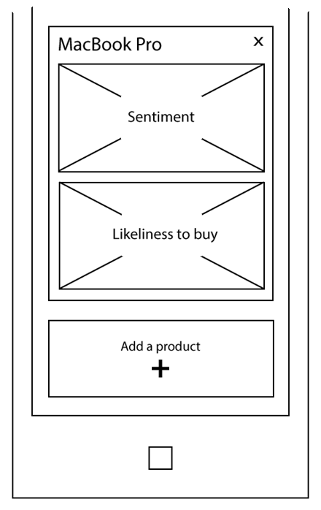
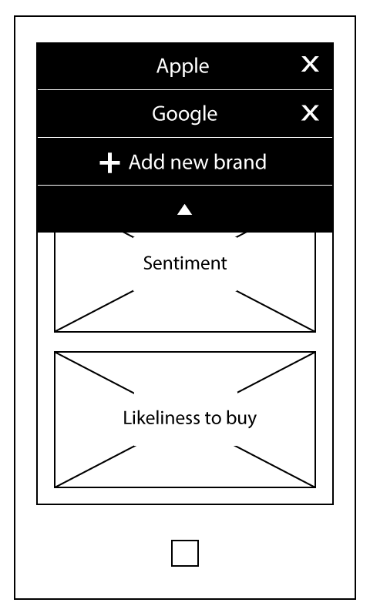
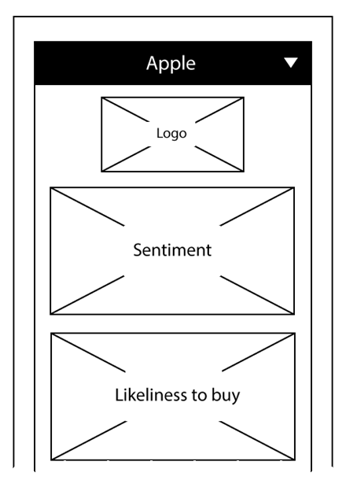
Screen Mockups: Phone Interface
Example Screen Mockups
Delete this slide.
DELETE ME.

Slide 10
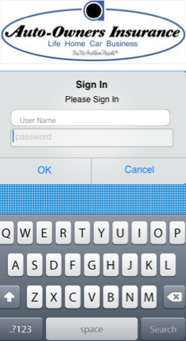
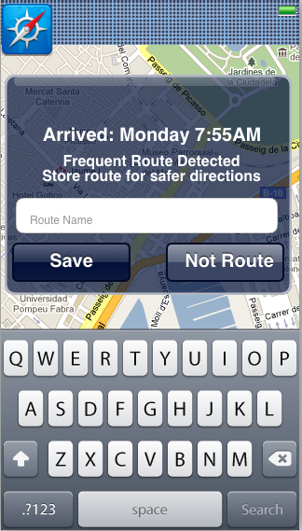
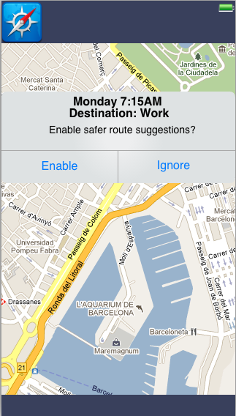
Screen Mockup: iOS Application
Example Screen Mockups
Delete this slide.
DELETE ME.

Slide 11
Technical Specifications
Point 1
Point 2
Point 3
Etc…
List the technical components of your project.
DELETE THIS TEXT BOX.

Slide 12
System Architecture
Show a diagram that illustrates the overall architecture of your project including how all of the parts and pieces are connected and interact.
See below for examples and instructions.
DELETE THIS TEXT BOX.

Slide 13
System Architecture
Notes on Making Your Diagram
Delete this slide.
Ensure that your diagram is…
  readable (size-wise),
  has the correct aspect ratio,
  scalable, and
  centered vertically (between the green bar in the title and the footer) and horizontally (Use Home > Arrange > Align).
In PowerPoint use Home > Arrange > Group to group the objects in your diagram into a single that can be copied-and-pasted.
Use Paint.NET to make the background of your diagram transparent.
  Download and install it from www.getpaint.net.
  Copy your diagram into Paint.NET.
  Select Tool > Magic Wand.
  Click on a background area.
  Push the Delete button (on your keyboard).
  The background area should be a checkerboard pattern.
  (N.B.: Paint.NET was a capstone project at the University of Washington.)
DELETE ME.

Slide 14
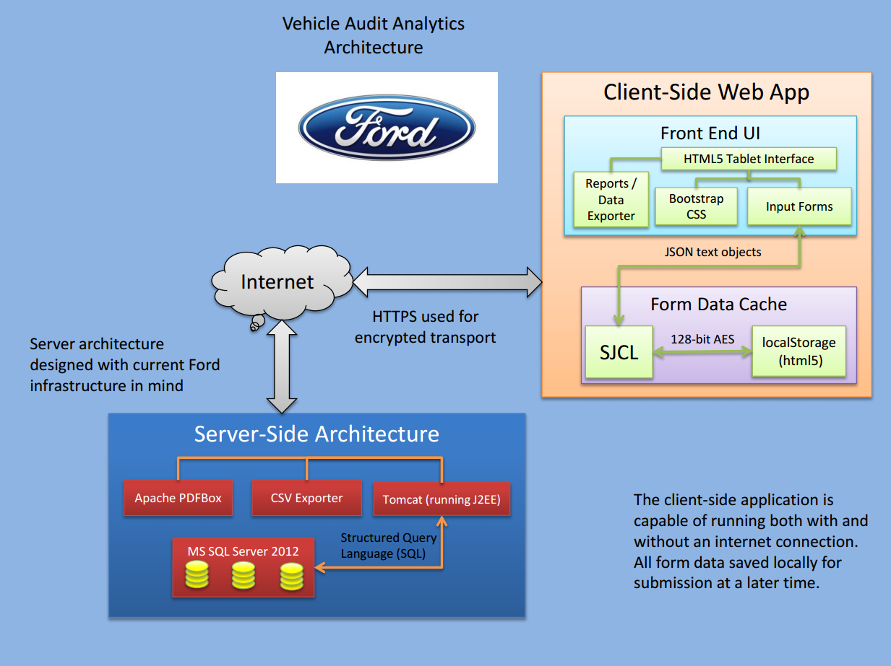
System Architecture
Example System Architecture
Delete this slide.
DELETE ME.

Slide 15
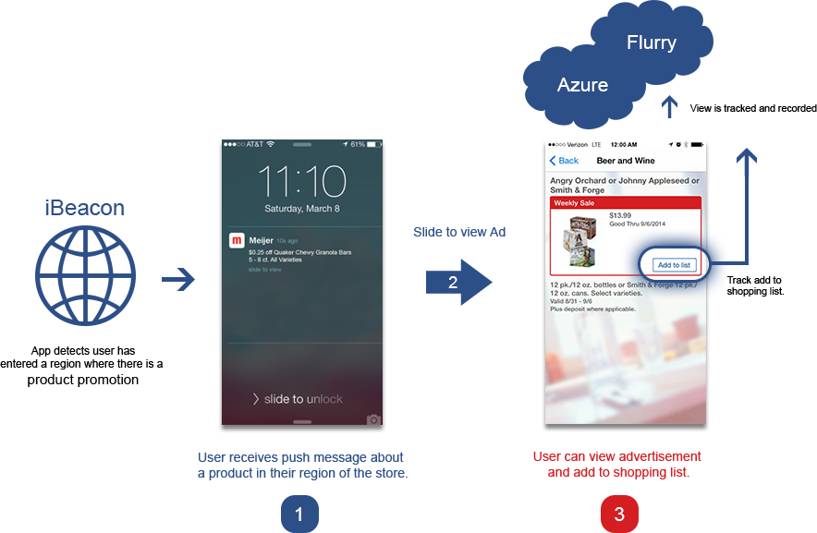
System Architecture
Example System Architecture
Delete this slide.
DELETE ME.

Slide 16
System Components
Hardware Platforms
  Point 1
  Point 2
  Point 3
  Etc…
Software Platforms / Technologies
  Point 1
  Point 2
  Point 3
  Etc…
List your hardware and software platforms including all of the technologies that your project will use.
DELETE THIS TEXT BOX.

Slide 17
Testing
Point 1
Point 2
Point 3
Etc…
Articulate your plans for testing your software system.
List any tools that you plan to use.
DELETE THIS TEXT BOX.

Slide 18
Risks
Risk 1
  Description
  Mitigation
Risk 2
  Description
  Mitigation
Risk 3
  Description
  Mitigation
Risk 4
  Description
  Mitigation
Articulate your major risks.
For each risk, describe what the risk is and how you plan on mitigating it.
DELETE THIS TEXT BOX.

Slide 19
Questions?
?
?
?
?
?
?
?
?
?

