Slide 1
Read Me Carefully (Delete this slide.)
Required Template
  Do not edit the Slide Masters.
  Do edit the Handout Master (6 Slides Per Page)
    In the lower left footer, change <Company Name> to your company name.
    In the lower left footer, change <Project Title> to your project title as found on the course web site.
  Do not change the organization of slides.
  You may duplicate slides as necessary but keep in mind that your presentation time is limited strictly to 15 minutes.
Content
  Do not include any company confidential information in your presentation since all presentations will be posted on the web site.
  Submit your presentation to your client for approval at least two working days in advance.
  Throughout the PowerPoint template, replace placeholders <…> with the appropriate information.
  Edit the center footer by clicking the Header & Footer button on the Insert ribbon. Change <Company Name> in the footer to your company name as in “Team Ford Project Plan”.
  Delete the example Screen Mockups and System Architecture slides and this Read Me slide from your presentation.
Presenting
  Although the presentations are scheduled over the course of four meetings, all teams must be prepared to present on the first day scheduled, Monday, September 17.
  The order of the presentations will be posted on our All-Hands Meetings page in the afternoon or evening of the day before the first day scheduled for presentations.
  The time limit for your presentation is 15 minutes, which will be strictly enforced. Practice your presentation to ensure that you will finish within the allotted time.
  All team members are required to dress business casual on the day of your presentation.
  “Formal” team photos of the presenting teams will be taken in the Capstone Lab immediately following these all-hands meetings.
Submission
  Email both the project plan document and presentation to Dr. D. by midnight, Sunday, September 16.
  For subject, use “Team <Company Name>: Project Plan” as in “Team Boeing: Project Plan”.
  Attach the Word source file named “team-<company-name>-project-plan.doc” as in “team-ge-aviation-project-plan.doc”.
  Attach the PowerPoint source file named “team-<company-name>-project-plan-presentation.ppt” as in “team-quicken-loans-project-plan-presentation.ppt”.
DELETE ME.

Slide 2
Project Plan
<Project Title 36pt>
Team <Company Name 24pt>
<Team Member 1 16pt>
<Team Member 2 16pt>
<Team Member 3 16pt>
<Team Member 4 16pt>
Department of Computer Science and Engineering
Michigan State University
Fall 2012

Slide 3
Project Overview
Point 1
Point 2
Point 3
Etc…

Slide 4
Functional Specifications
Point 1
Point 2
Point 3
Etc…

Slide 5
Design Specifications
Point 1
Point 2
Point 3
Etc…

Slide 6
Screen Mockup: <Title>

Slide 7
Screen Mockup: <Title>

Slide 8
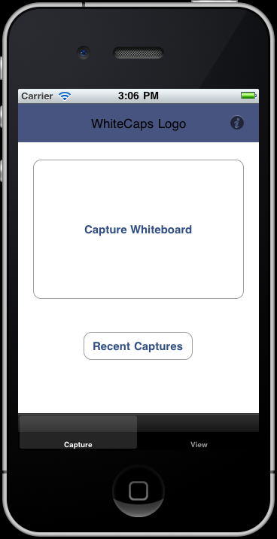
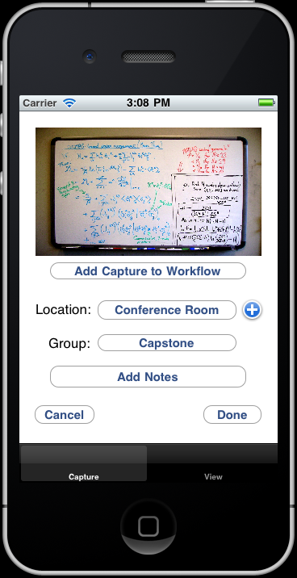
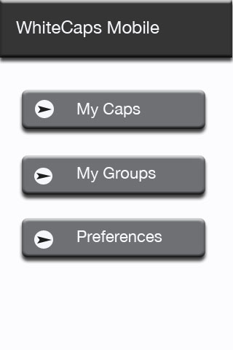
Screen Mockups: iPhone Interface
Example Screen Mockups
Delete this slide.
DELETE ME.

Slide 9
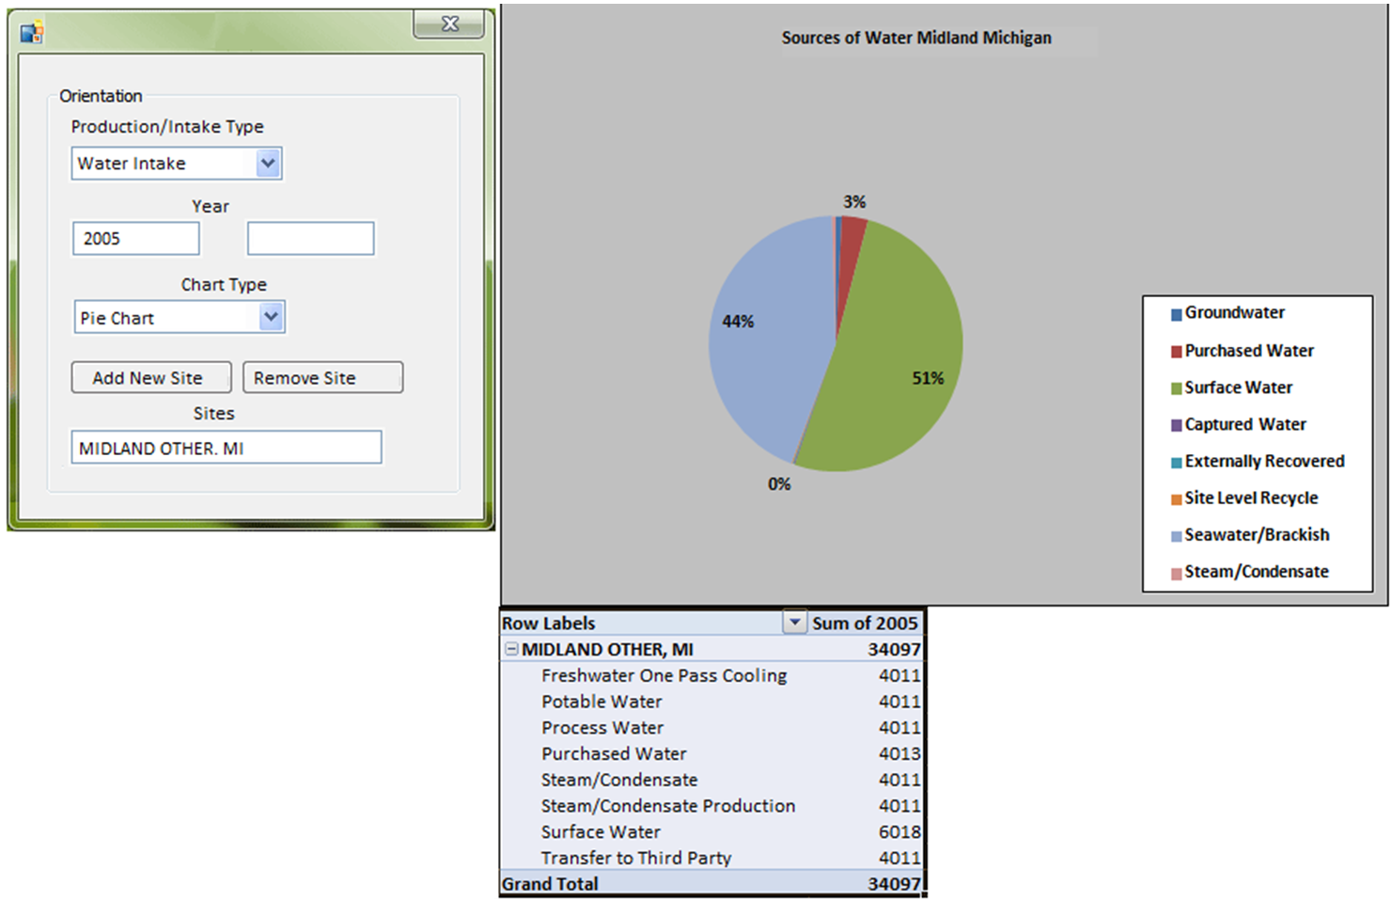
Screen Mockup: Home Page
Example Screen Mockups
Delete this slide.
DELETE ME.

Slide 10
Technical Specifications
Point 1
Point 2
Point 3
Etc…

Slide 11
System Architecture

Slide 12
System Architecture
Notes on Making Your Diagram
Delete this slide.
Ensure that your diagram is…
  readable (size-wise),
  scalable, and
  centered vertically (between the green bar in the title and the footer) and horizontally (Use Home > Arrange > Align).
In PowerPoint use Home > Arrange > Group to group the objects in your diagram into a single that can be copied-and-pasted.
Use Paint.NET to make the background of your diagram transparent.
  Download and install it from www.getpaint.net.
  Copy your diagram into Paint.NET.
  Select Tool > Magic Wand.
  Click on a background area.
  Push the Delete button (on your keyboard).
  The background area should be a checkerboard pattern.
DELETE ME.

Slide 13
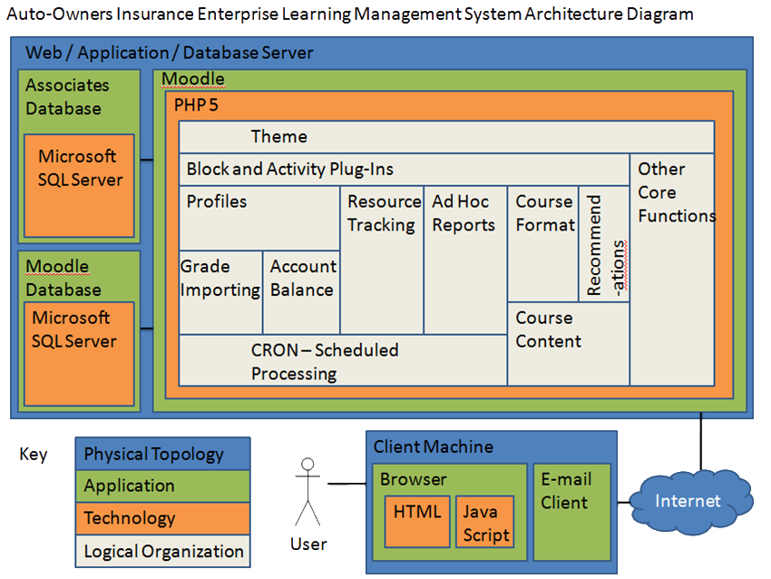
System Architecture
Example System Architecture
Delete this slide.
DELETE ME.

Slide 14
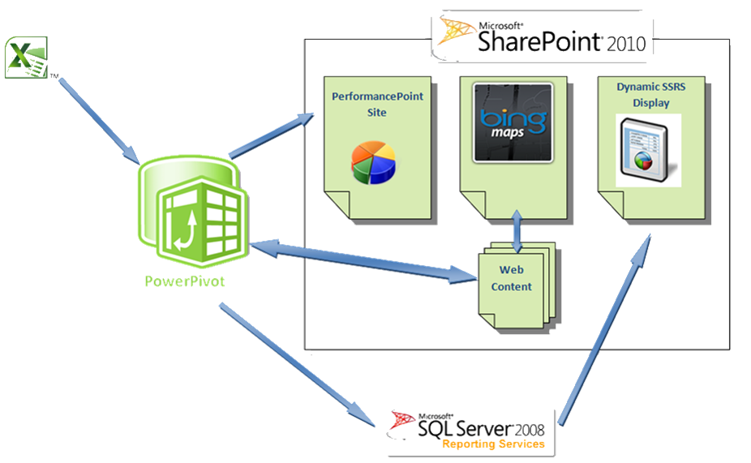
System Architecture
Example System Architecture
Delete this slide.
DELETE ME.

Slide 15
System Components
Hardware Platforms
  Point 1
  Point 2
  Point 3
  Etc…
Software Platforms / Technologies
  Point 1
  Point 2
  Point 3
  Etc…

Slide 16
Testing
Point 1
Point 2
Point 3
Etc…

Slide 17
Risks
Risk 1
Risk 2
Risk 3
Risk 4
Etc…
DELETE ME
For each risk, articulate what the risk is and how you plan on mitigating it.

