Slide 1
Read Me (Delete this slide.)
Required Template
  Do not edit the Slide Masters.
  Do edit the Handout Master (6 Slides Per Page)
    In the lower left footer, change <Company Name> to your company name.
    In the lower left footer, change <Project Title> to your project title as found on the course web site.
  Do not change the organization of slides.
  You may duplicate slides as necessary but keep in mind that your presentation time is limited strictly to 15 minutes.
Content
  Do not include any company confidential information in your presentation since all presentations will be posted on the web site.
  Submit your presentation to your client for approval at least two working days in advance.
  Throughout the PowerPoint template, replace placeholders <…> with the appropriate information.
  Edit the center footer by clicking the Header & Footer button on the Insert ribbon. Change <Company Name> in the footer to your company name as in “Team Ford Project Plan”.
  Delete the example System Architecture slides and this Read Me slide from your presentation.
Presenting
  Although the presentations are scheduled over the course of three meetings, all teams must be prepared to present on the first day scheduled, Wednesday, September 21.
  The order of the presentations will be posted on our All-Hands Meetings page in the afternoon or evening of the day before the first day scheduled for presentations.
  The time limit for your presentation is 15 minutes, which will be strictly enforced. Practice your presentation to ensure that you will finish within the allotted time.
  All team members are required to dress business casual on the day of your presentation.
  “Formal” team photos of the presenting teams will be taken in the Capstone Lab immediately following these all-hands meetings.
Submission
  Email both the project plan document and presentation to Dr. D. by noon, Wednesday, September 21.
  For subject, use “Team <Company Name>: Project Plan” as in “Team Boeing: Project Plan”.
  Attach the Word source file named “team-<company-name>-project-plan.doc” as in “team-ge-aviation-project-plan.doc”.
  Attach the PowerPoint source file named “team-<company-name>-project-plan-presentation.ppt” as in “team-motorola-mobility-project-plan-presentation.ppt”.

Slide 2
Project Plan
<Project Title 36pt>
Team <Company Name 24pt>
<Team Member 1 16pt>
<Team Member 2 16pt>
<Team Member 3 16pt>
<Team Member 4 16pt>
Department of Computer Science and Engineering
Michigan State University
Fall 2011

Slide 3
Project Overview
Point 1
Point 2
Point 3
Etc…

Slide 4
Functional Specifications
Point 1
Point 2
Point 3
Etc…

Slide 5
Design Specifications
Point 1
Point 2
Point 3
Etc…

Slide 6
Screen Mockups

Slide 7
Screen Mockups

Slide 8
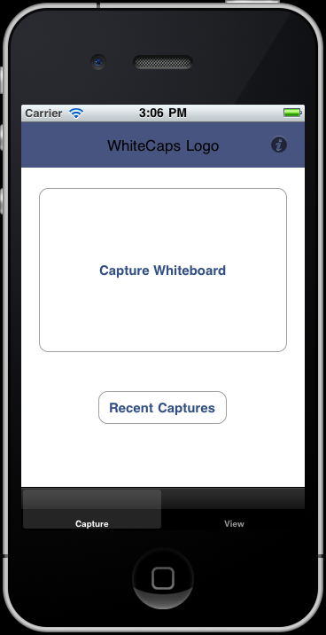
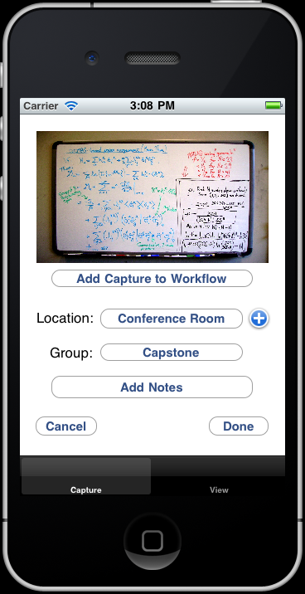
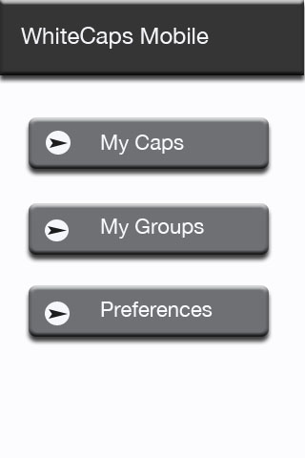
Screen Mockups
Example Screen Mockups
Delete this slide.
DELETE ME.

Slide 9
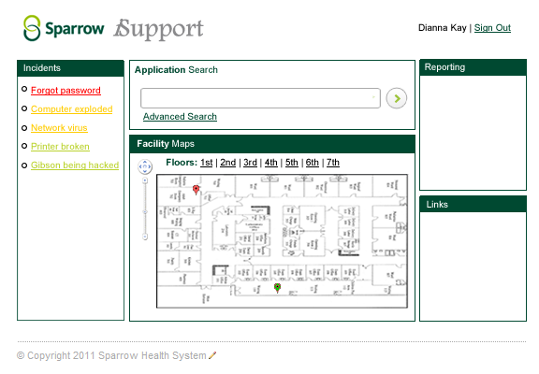
Screen Mockup
Example Screen Mockup
Delete this slide.
DELETE ME.

Slide 10
Technical Specifications
Point 1
Point 2
Point 3
Etc…

Slide 11
System Architecture

Slide 12
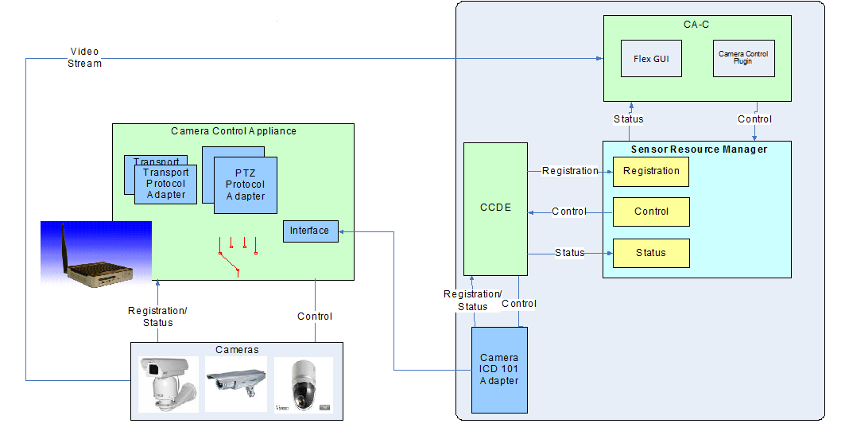
System Architecture
Example System Architecture
Delete this slide.
DELETE ME.

Slide 13
System Architecture
Example System Architecture
Delete this slide.
DELETE ME.

Slide 14
System Components
Hardware Platforms
  Point 1
  Point 2
  Point 3
  Etc…
Software Platforms / Technologies
  Point 1
  Point 2
  Point 3
  Etc…

Slide 15
Testing
Point 1
Point 2
Point 3
Etc…

Slide 16
Risks
Risk 1
Risk 2
Risk 3
Risk 4
Etc…

