Slide 1
Read Me Carefully (Delete this slide.)
Required Template
Do not edit the Slide Masters.
Do edit the Handout Master (6 Slides Per Page)
In the lower left footer, change <Company Name> to your company name.
In the lower left footer, change <Project Title> to your project title as found on our Projects web page.
Do not change the organization of slides.
You may duplicate slides as necessary but keep in mind that your presentation time is limited strictly to 15 minutes.
Content
Do not include any company confidential information in your presentation since all presentations will be posted on the web site.
Submit your presentation to your client for approval at least two working days in advance.
Throughout the PowerPoint template, replace placeholders <…> with the appropriate information.
Edit the center footer by clicking the Header & Footer button on the Insert ribbon. Change <Company Name> in the footer to your company name as in “Team GM Project Plan”.
Delete the example Screen Mockups and System Architecture slides and this Read Me slide from your presentation.
Presenting
Although the presentations are scheduled over the course of four meetings, all teams must be prepared to present on the first day scheduled, Monday, February 2.
The order of the presentations will be posted on our All-Hands Meetings page in the afternoon or evening of the day before the first day scheduled for presentations.
The time limit for your presentation is 15 minutes, which will be strictly enforced. Practice your presentation to ensure that you will finish within the allotted time.
All team members are required to dress business casual on the day of your presentation.
“Formal” team photos of the presenting teams will be taken in the Capstone Lab immediately following these all-hands meetings.
Submission
Email both the project plan document and presentation to Dr. D. by 4:00 a.m., Monday, February 2.
For subject, use “Team <Company Name>: Project Plan” as in “Team Boeing: Project Plan”.
Attach the Word source file named “team-<company-name>-project-plan.docx” as in “team-urban-science-project-plan.docx”.
Attach the PowerPoint source file named “team-<company-name>-project-plan-presentation.pptx” as in “team-quicken-loans-project-plan-presentation.pptx”.
DELETE ME.

Slide 2
Project Plan <Project Title 36pt>
Team <Company Name 24pt>
<Team Member 1 16pt>
<Team Member 2 16pt>
<Team Member 3 16pt>
<Team Member 4 16pt>
<Team Member 5 16pt>
Department of Computer Science and Engineering
Michigan State University
Spring 2015

Slide 3
Functional Specifications
Point 1
Point 2
Point 3
Etc…
This is your project overview.
Describe what problem your project solves.
Answer the question “What does your project do?”
This is your “elevator pitch”.
DELETE THIS TEXT BOX.

Slide 4
Design Specifications
Point 1
Point 2
Point 3
Etc…
Articulate a summary of your project’s major features as well as its overall design.
DELETE THIS TEXT BOX.

Slide 5
Screen Mockup: <Title>
You may include as many screen mockups as you have like, but you must include at least two examples.
To include more than two, you can duplicate this slide as many times as necessary.
Give each mockup slide a title.
See below for examples and instructions.
DELETE THIS TEXT BOX.

Slide 6
Screen Mockup: <Title>
You may include as many screen mockups as you have like, but you must include at least two examples.
To include more than two, you can duplicate this slide as many times as necessary.
Give each mockup slide a title.
See below for examples and instructions.
DELETE THIS TEXT BOX.

Slide 7
Screen Mockup
Notes on Making Your Mockups
Delete this slide.
Ensure that your mockups are…
readable (size-wise),
have the correct aspect ratio,
scalable, and
centered vertically (between the green bar in the title and the footer) and horizontally (Use Home > Arrange > Align).
In PowerPoint use Home > Arrange > Group to group the objects in your mockup into a single object that can be copied-and-pasted (and scaled).
DELETE ME.

Slide 8
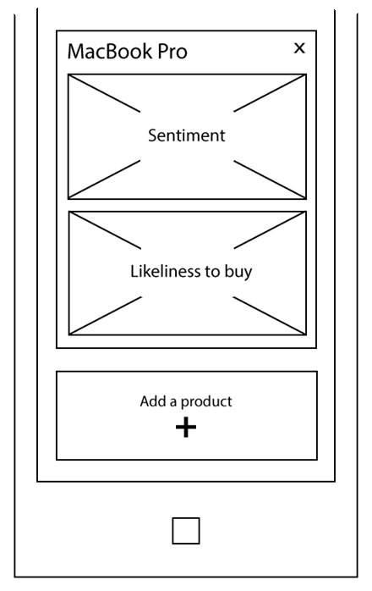
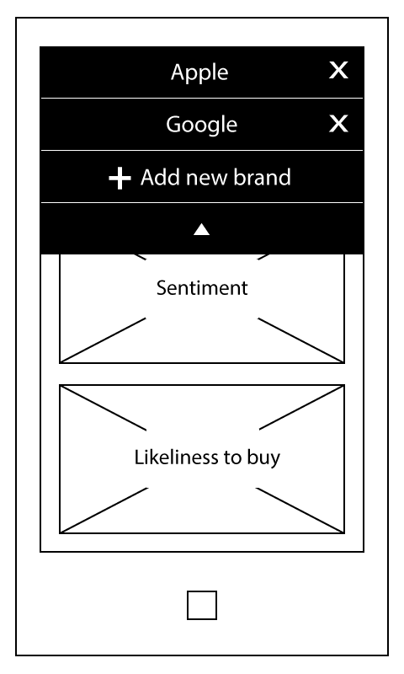
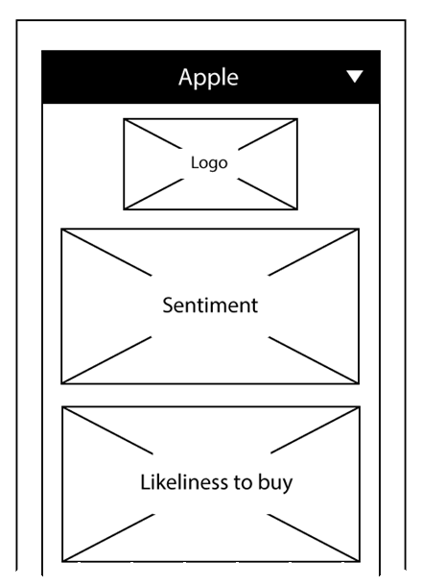
Screen Mockups: Phone Interface
Example Screen Mockups
Delete this slide.
DELETE ME.

Slide 9
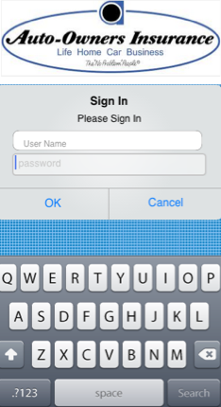
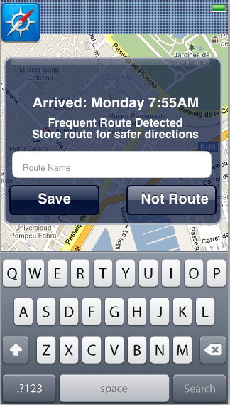
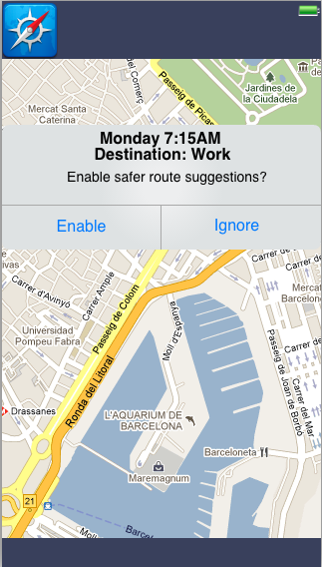
Screen Mockup: iOS Application
Example Screen Mockups
Delete this slide.
DELETE ME.

Slide 10
Technical Specifications
Point 1
Point 2
Point 3
Etc…
List the technical components of your project.
DELETE THIS TEXT BOX.

Slide 11
System Architecture
Show a diagram that illustrates the overall architecture of your project including how all of the parts and pieces are connected and interact.
See below for examples and instructions.
DELETE THIS TEXT BOX.

Slide 12
System Architecture
Notes on Making Your Diagram
Delete this slide.
Ensure that your diagram is…
readable (size-wise),
has the correct aspect ratio,
scalable, and
centered vertically (between the green bar in the title and the footer) and horizontally (Use Home > Arrange > Align).
In PowerPoint use Home > Arrange > Group to group the objects in your diagram into a single that can be copied-and-pasted.
Use Paint.NET to make the background of your diagram transparent.
Download and install it from www.getpaint.net.
Copy your diagram into Paint.NET.
Select Tool > Magic Wand.
Click on a background area.
Push the Delete button (on your keyboard).
The background area should be a checkerboard pattern.
(N.B.: Paint.NET was a capstone project at the University of Washington.)
DELETE ME.

Slide 13
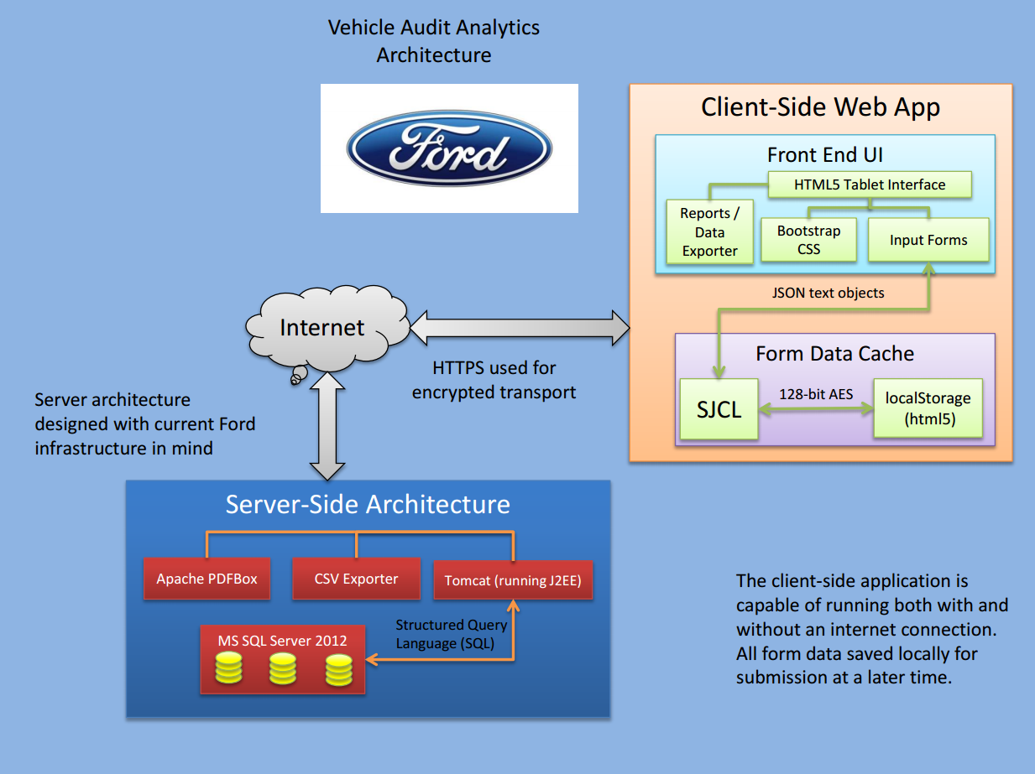
System Architecture
Example System Architecture
Delete this slide.
DELETE ME.

Slide 14
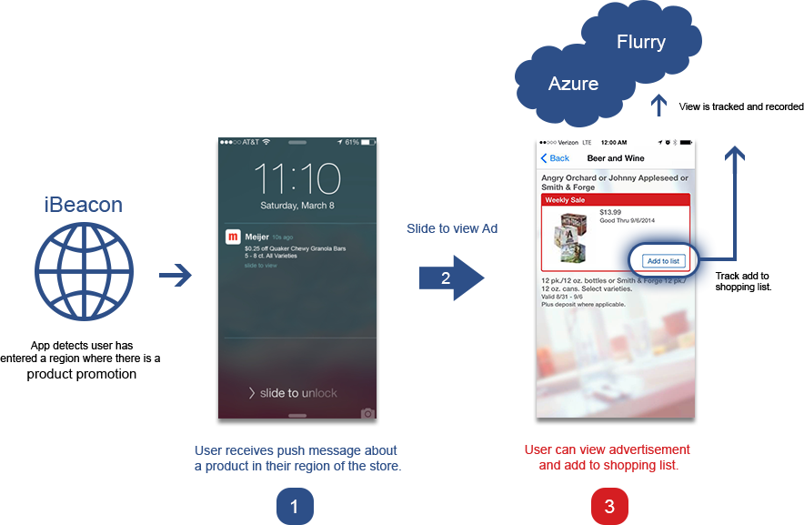
System Architecture
Example System Architecture
Delete this slide.
DELETE ME.

Slide 15
System Components
Hardware Platforms
Point 1
Point 2
Point 3
Etc…
Software Platforms / Technologies
Point 1
Point 2
Point 3
Etc…
List your hardware and software platforms including all of the technologies that your project will use.
DELETE THIS TEXT BOX.

Slide 16
Testing
Point 1
Point 2
Point 3
Etc…
Articulate your plans for testing your software system.
List any tools that you plan to use.
DELETE THIS TEXT BOX.

Slide 17
Risks
Risk 1
Risk 2
Risk 3
Risk 4
Etc…
Articulate your major risks.
For each risk, describe what the risk is and how you plan on mitigating it.
DELETE THIS TEXT BOX.

